Slide 1
Informed consent? A study of “consent dialogs” on Android and iOS
Benjamin Altpeter, 2022-05-19

Slide 2
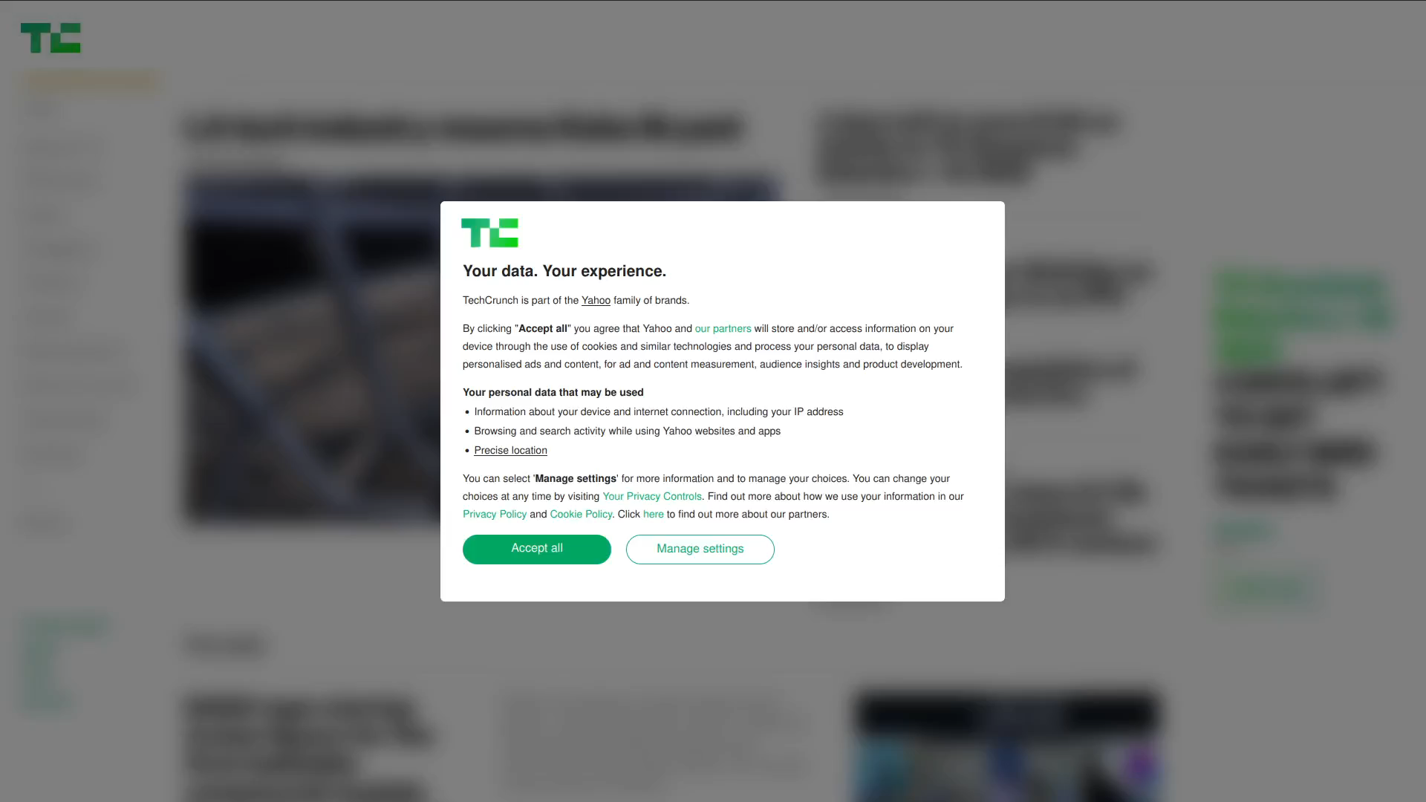
[4x]
https://techcrunch.com

Slide 3
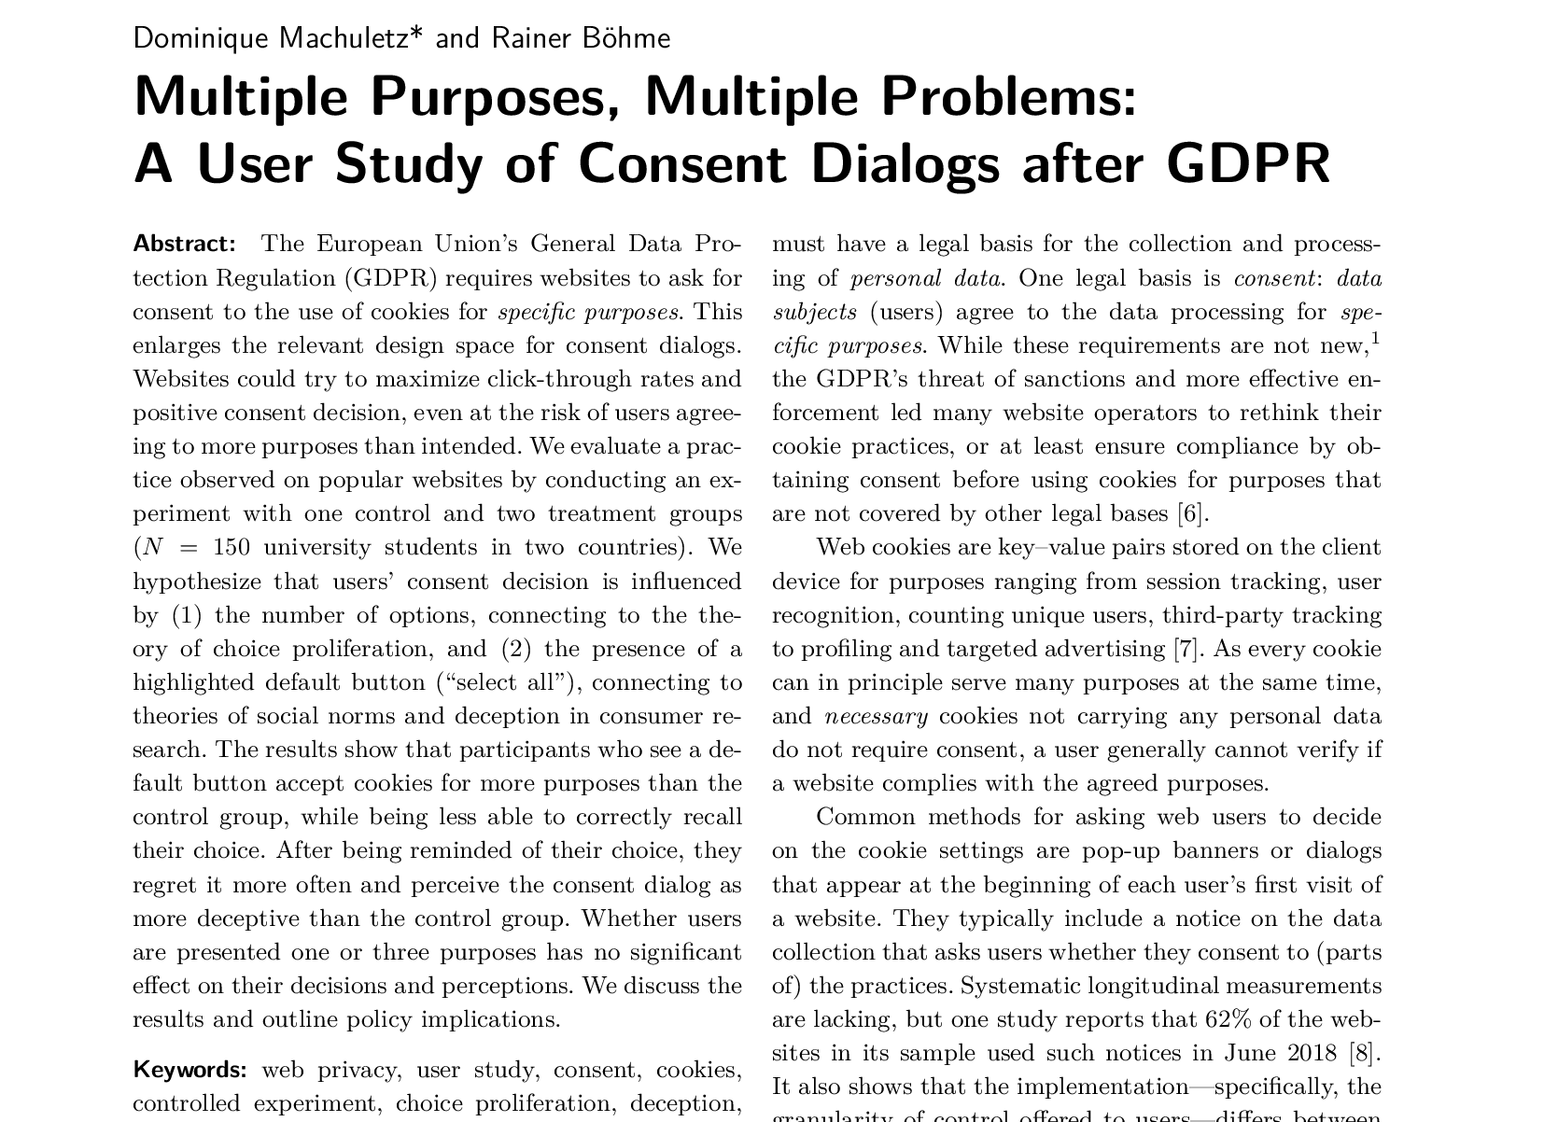
More than just annoying
D. Machuletz and R. Böhme, “Multiple Purposes, Multiple Problems: A User Study of Consent Dialogs after GDPR,” 10.2478/popets-2020-0037.

Slide 4
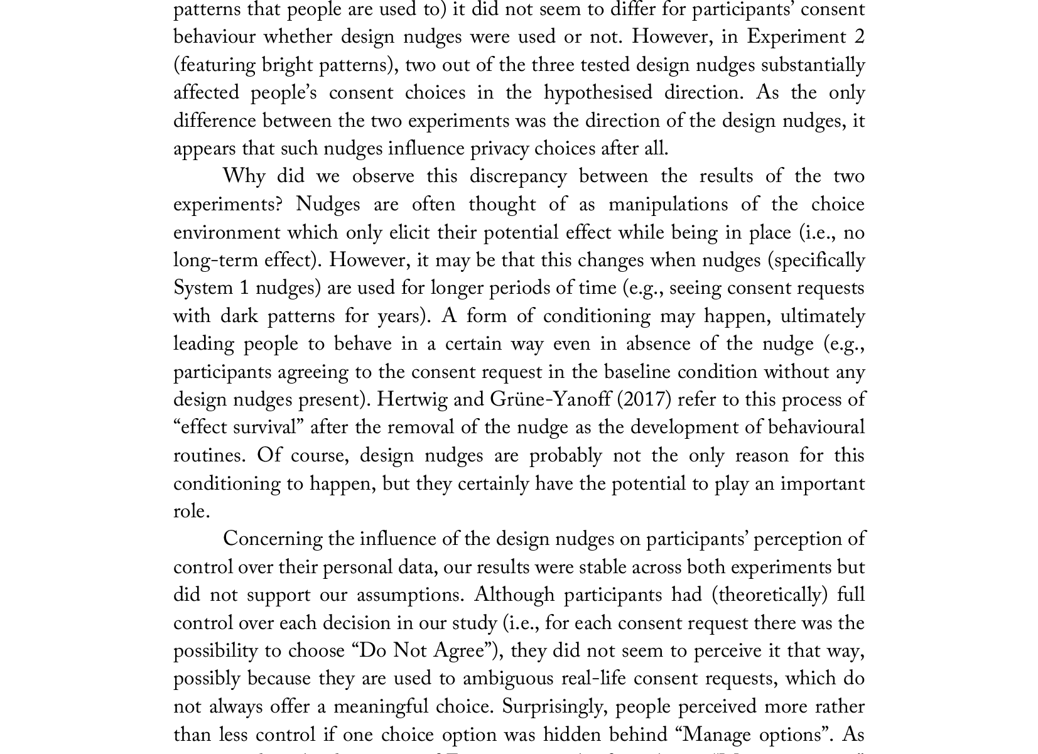
More than just annoying
P. Graßl, H. Schraffenberger, F. Z. Borgesius, and M. Buijzen, “Dark and Bright Patterns in Cookie Consent Requests,” 10.33621/jdsr.v3i1.54.

Slide 5

Legal situation
Image: Sebastian Pichler (Unsplash license)

Slide 6
General Data Protection Regulation (GDPR)
Concerns itself with the processing of personal data (Art. 2(1) GDPR).

Slide 7
General Data Protection Regulation (GDPR)
Concerns itself with the processing of personal data (Art. 2(1) GDPR).
Both terms defined in Art. 4 GDPR:
personal data: “any information relating to an identified or identifiable natural person […]”
processing: “any operation […] performed on personal data […]”

Slide 8
General Data Protection Regulation (GDPR)
Concerns itself with the processing of personal data (Art. 2(1) GDPR).
Both terms defined in Art. 4 GDPR:
personal data: “any information relating to an identified or identifiable natural person […]”
processing: “any operation […] performed on personal data […]”
Explicitly very broad terms, in essence any data that can somehow be connected to a person (including pseudonymously!) and that a company deals with in some way is covered by the GDPR.

Slide 9
Legal bases
Processing personal data is only legal if (Art. 6(1) GDPR):
“the data subject has given consent […]”;
“processing is necessary for the performance of a contract to which the data subject is party […]”;
“processing is necessary for compliance with a legal obligation [of] the controller […]”;
“processing is necessary in order to protect the vital interests of the data subject or of another natural person”;
“processing is necessary for the performance of a task carried out in the public interest or in the exercise of official authority vested in the controller”;
“processing is necessary for the purposes of the legitimate interests pursued by the controller or by a third party, except where such interests are overridden by the interests or fundamental rights and freedoms of the data subject which require protection of personal data, in particular where the data subject is a child”.

Slide 10
Legal bases
Processing personal data is only legal if (Art. 6(1) GDPR):
“the data subject has given consent […]”;
“processing is necessary for the performance of a contract to which the data subject is party […]”;
“processing is necessary for compliance with a legal obligation [of] the controller […]”;
“processing is necessary in order to protect the vital interests of the data subject or of another natural person”;
“processing is necessary for the performance of a task carried out in the public interest or in the exercise of official authority vested in the controller”;
“processing is necessary for the purposes of the legitimate interests pursued by the controller or by a third party, except where such interests are overridden by the interests or fundamental rights and freedoms of the data subject which require protection of personal data, in particular where the data subject is a child”.

Slide 11
Legal basis for tracking
Processing personal data is only legal if (Art. 6(1) GDPR):
“the data subject has given consent […]”;
“processing is necessary for the performance of a contract to which the data subject is party […]”;
“processing is necessary for compliance with a legal obligation [of] the controller […]”;
“processing is necessary in order to protect the vital interests of the data subject or of another natural person”;
“processing is necessary for the performance of a task carried out in the public interest or in the exercise of official authority vested in the controller”;
“processing is necessary for the purposes of the legitimate interests pursued by the controller or by a third party, except where such interests are overridden by the interests or fundamental rights and freedoms of the data subject which require protection of personal data, in particular where the data subject is a child”.

Slide 12
Legal basis for tracking
Processing personal data is only legal if (Art. 6(1) GDPR):
“the data subject has given consent […]”;
“processing is necessary for the performance of a contract to which the data subject is party […]”;
“processing is necessary for compliance with a legal obligation [of] the controller […]”;
“processing is necessary in order to protect the vital interests of the data subject or of another natural person”;
“processing is necessary for the performance of a task carried out in the public interest or in the exercise of official authority vested in the controller”;
“processing is necessary for the purposes of the legitimate interests pursued by the controller or by a third party, except where such interests are overridden by the interests or fundamental rights and freedoms of the data subject which require protection of personal data, in particular where the data subject is a child”.

Slide 13
Legal basis for tracking
Processing personal data is only legal if (Art. 6(1) GDPR):
“the data subject has given consent […]”;
“processing is necessary for the performance of a contract to which the data subject is party […]”;
“processing is necessary for compliance with a legal obligation [of] the controller […]”;
“processing is necessary in order to protect the vital interests of the data subject or of another natural person”;
“processing is necessary for the performance of a task carried out in the public interest or in the exercise of official authority vested in the controller”;
“processing is necessary for the purposes of the legitimate interests pursued by the controller or by a third party, except where such interests are overridden by the interests or fundamental rights and freedoms of the data subject which require protection of personal data, in particular where the data subject is a child”.

Slide 14
Legal basis for tracking
Processing personal data is only legal if (Art. 6(1) GDPR):
“the data subject has given consent […]”;
“processing is necessary for the performance of a contract to which the data subject is party […]”;
“processing is necessary for compliance with a legal obligation [of] the controller […]”;
“processing is necessary in order to protect the vital interests of the data subject or of another natural person”;
“processing is necessary for the performance of a task carried out in the public interest or in the exercise of official authority vested in the controller”;
“processing is necessary for the purposes of the legitimate interests pursued by the controller or by a third party, except where such interests are overridden by the interests or fundamental rights and freedoms of the data subject which require protection of personal data, in particular where the data subject is a child”.

Slide 15
ePrivacy Directive (“the cookie law”)
Art. 5(3) ePD applies to all data accessed from a device: “Member States shall ensure that the storing of information, or the gaining of access to information already stored, in the terminal equipment of a subscriber or user is only allowed on condition that the subscriber or user concerned has given his or her consent, having been provided with clear and comprehensive information […]. This shall not prevent any technical storage or access for the sole purpose of carrying out the transmission of a communication over an electronic communications network, or as strictly necessary in order for the provider of an information society service explicitly requested by the subscriber or user to provide the service.”

Slide 16
ePrivacy Directive (“the cookie law”)
No legal basis other than consent: “Member States shall ensure that the storing of information, or the gaining of access to information already stored, in the terminal equipment of a subscriber or user is only allowed on condition that the subscriber or user concerned has given his or her consent, having been provided with clear and comprehensive information […]. This shall not prevent any technical storage or access for the sole purpose of carrying out the transmission of a communication over an electronic communications network, or as strictly necessary in order for the provider of an information society service explicitly requested by the subscriber or user to provide the service.”

Slide 17

Consent dialog criteria
Image: Glenn Carstens-Peters (Unsplash license)

Slide 18
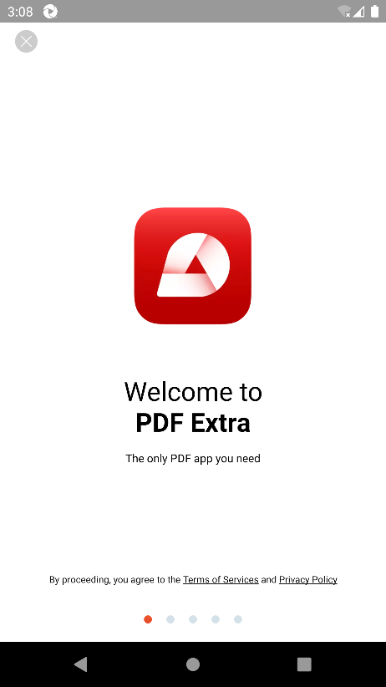

Clear affirmative action
PDF Extra - Scan, Edit & Sign (Android)
Blossom - Plant Care Guide (iOS)

Slide 19
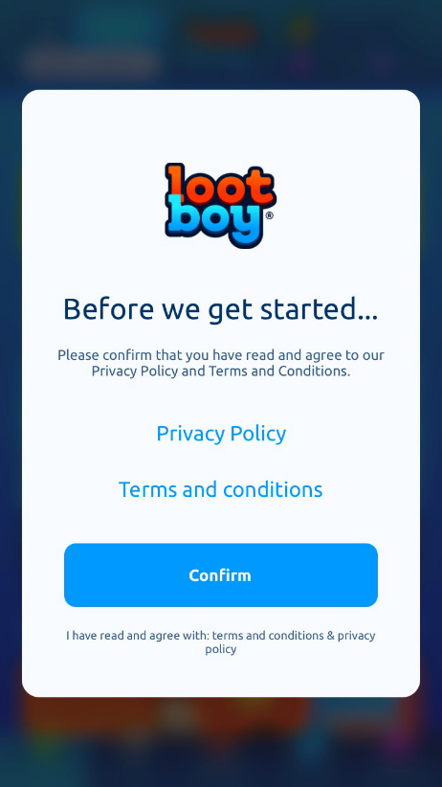
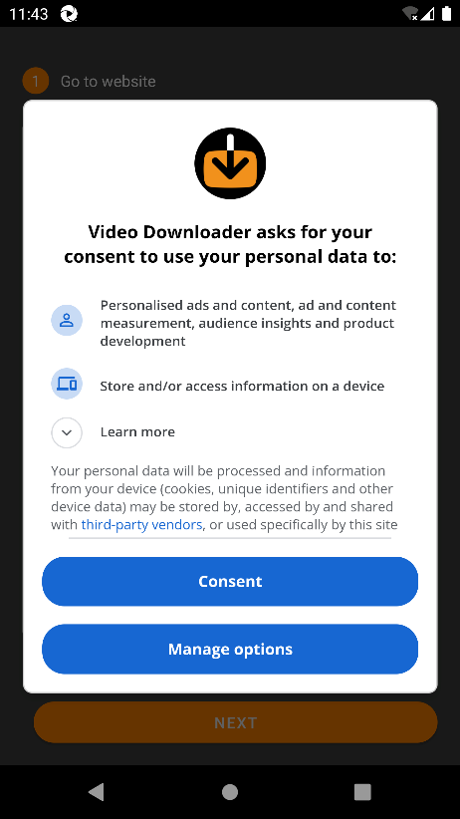
Refusing is as easy as accepting
LootBoy - Grab your loot! (iOS)
Video Downloader & Video Saver (Android)

Slide 20
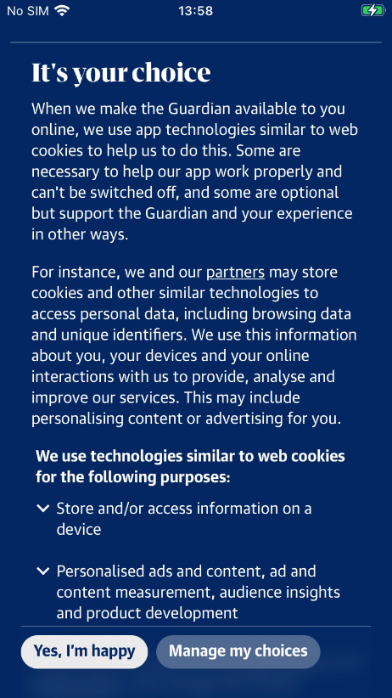
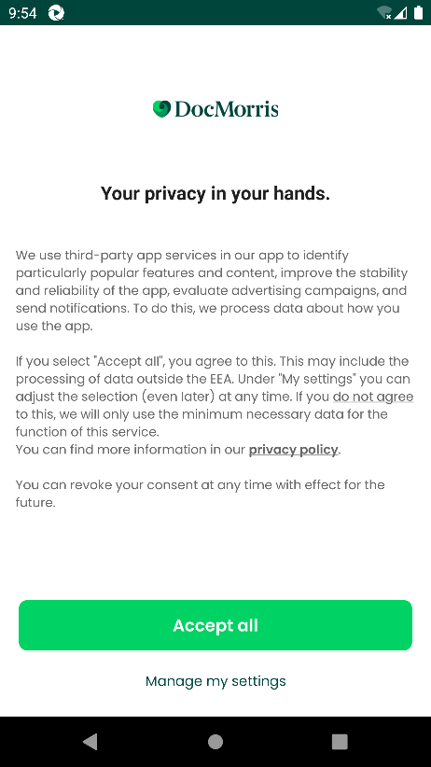
Unambiguous button labels
The Guardian: Breaking News (iOS)
DocMorris (Android)

Slide 21
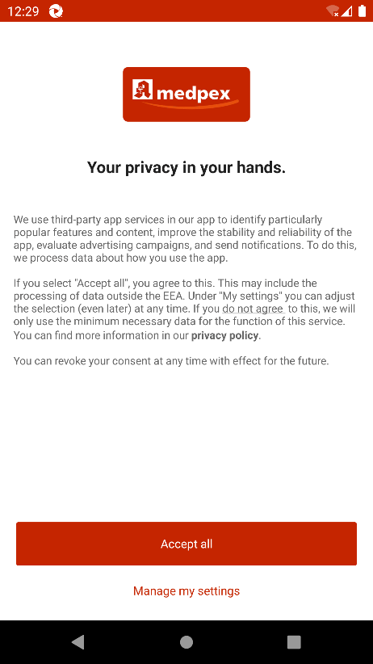
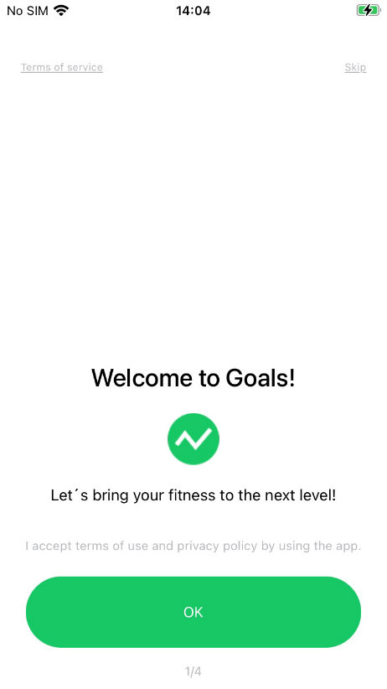
“Accept” button not highlighted by size
medpex: Online Apotheke (Android)
Running Walking Tracker Goals (iOS)

Slide 22
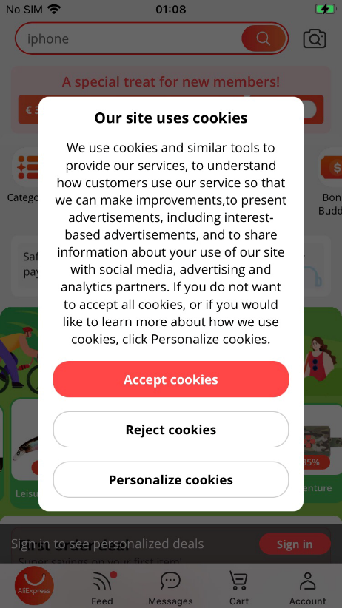
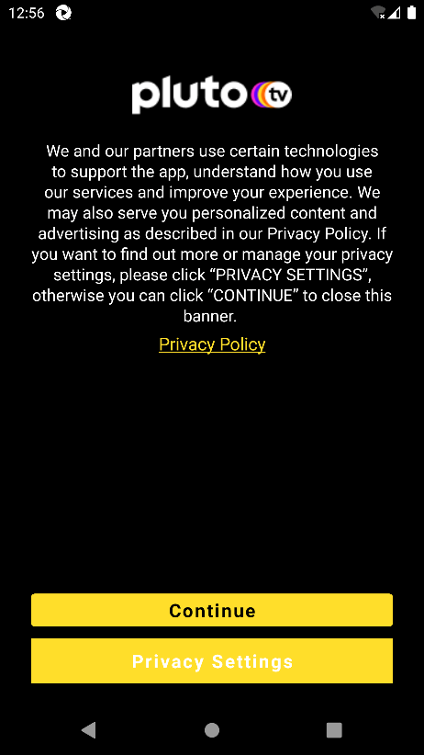
“Accept” button not highlighted by colour
AliExpress Shopping App (iOS)
Pluto TV - Live TV and Movies (Android)

Slide 23
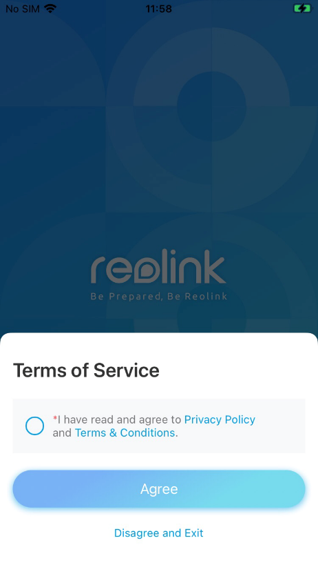
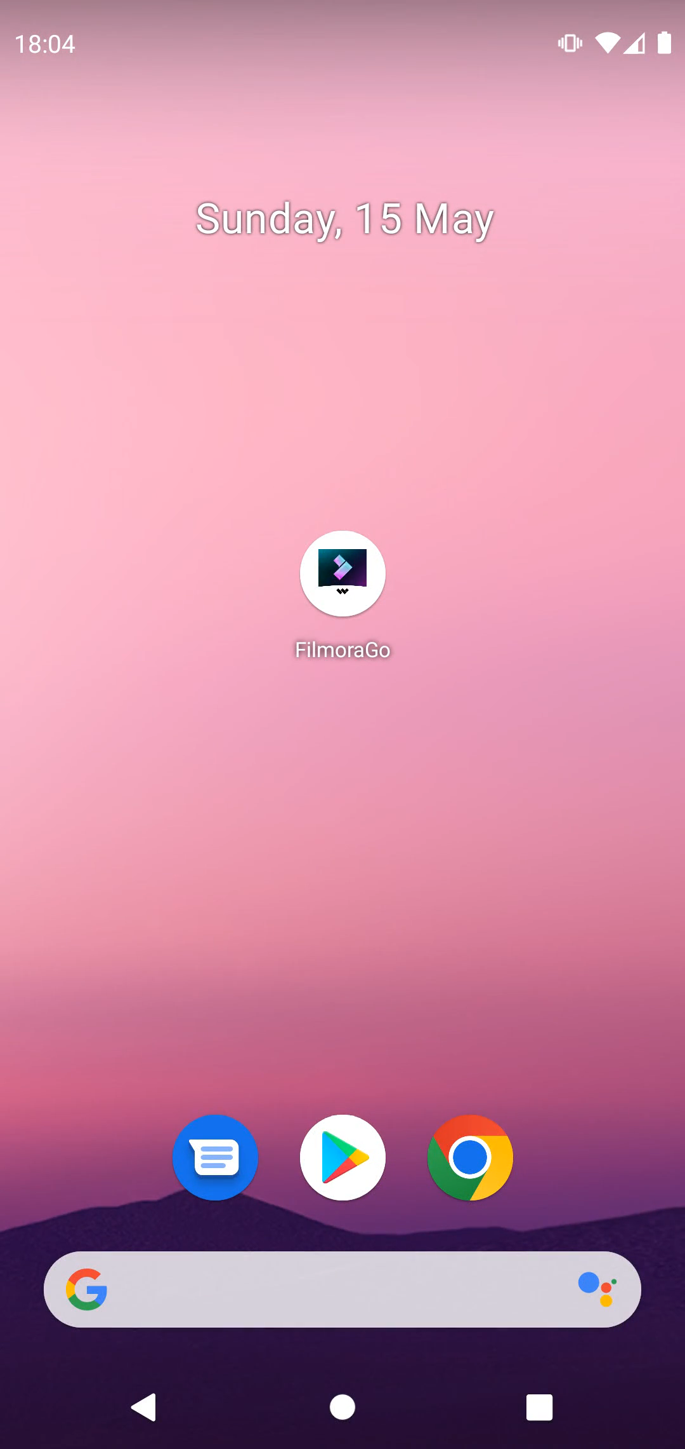
Consent not mandatory
Reolink (iOS)
FilmoraGo Video Editor & Maker (Android)

Slide 24
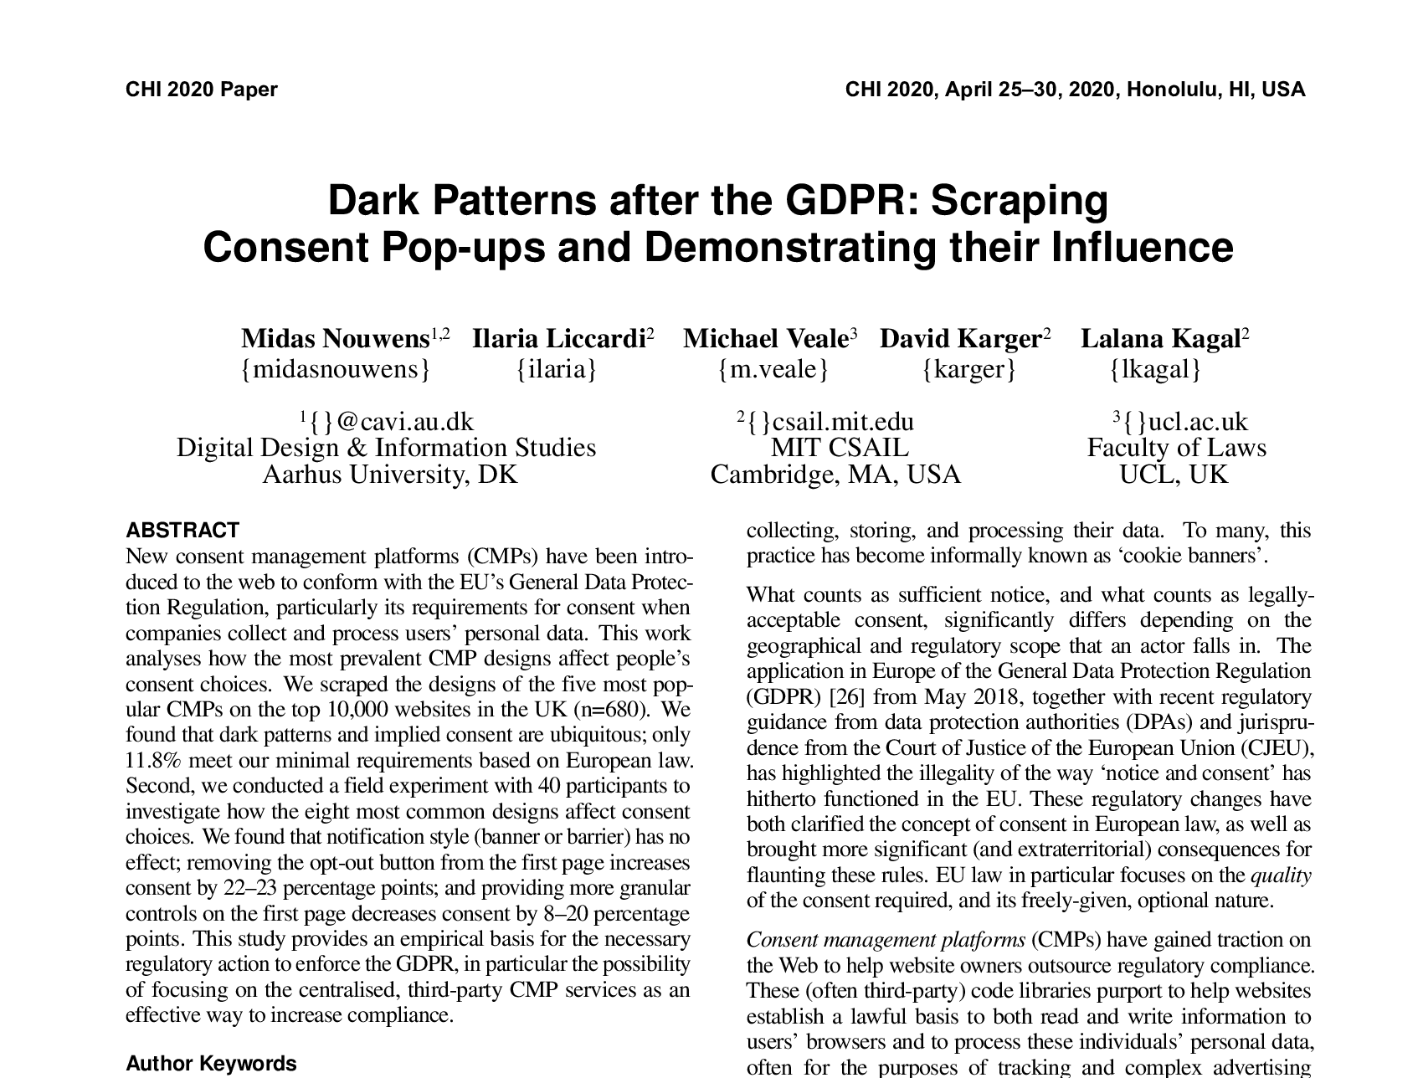
Violations are common on the web
M. Nouwens, I. Liccardi, M. Veale, D. Karger, and L. Kagal, “Dark Patterns after the GDPR:
Scraping Consent Pop-ups and Demonstrating their Influence,” 10.1145/3313831.3376321.

Slide 25
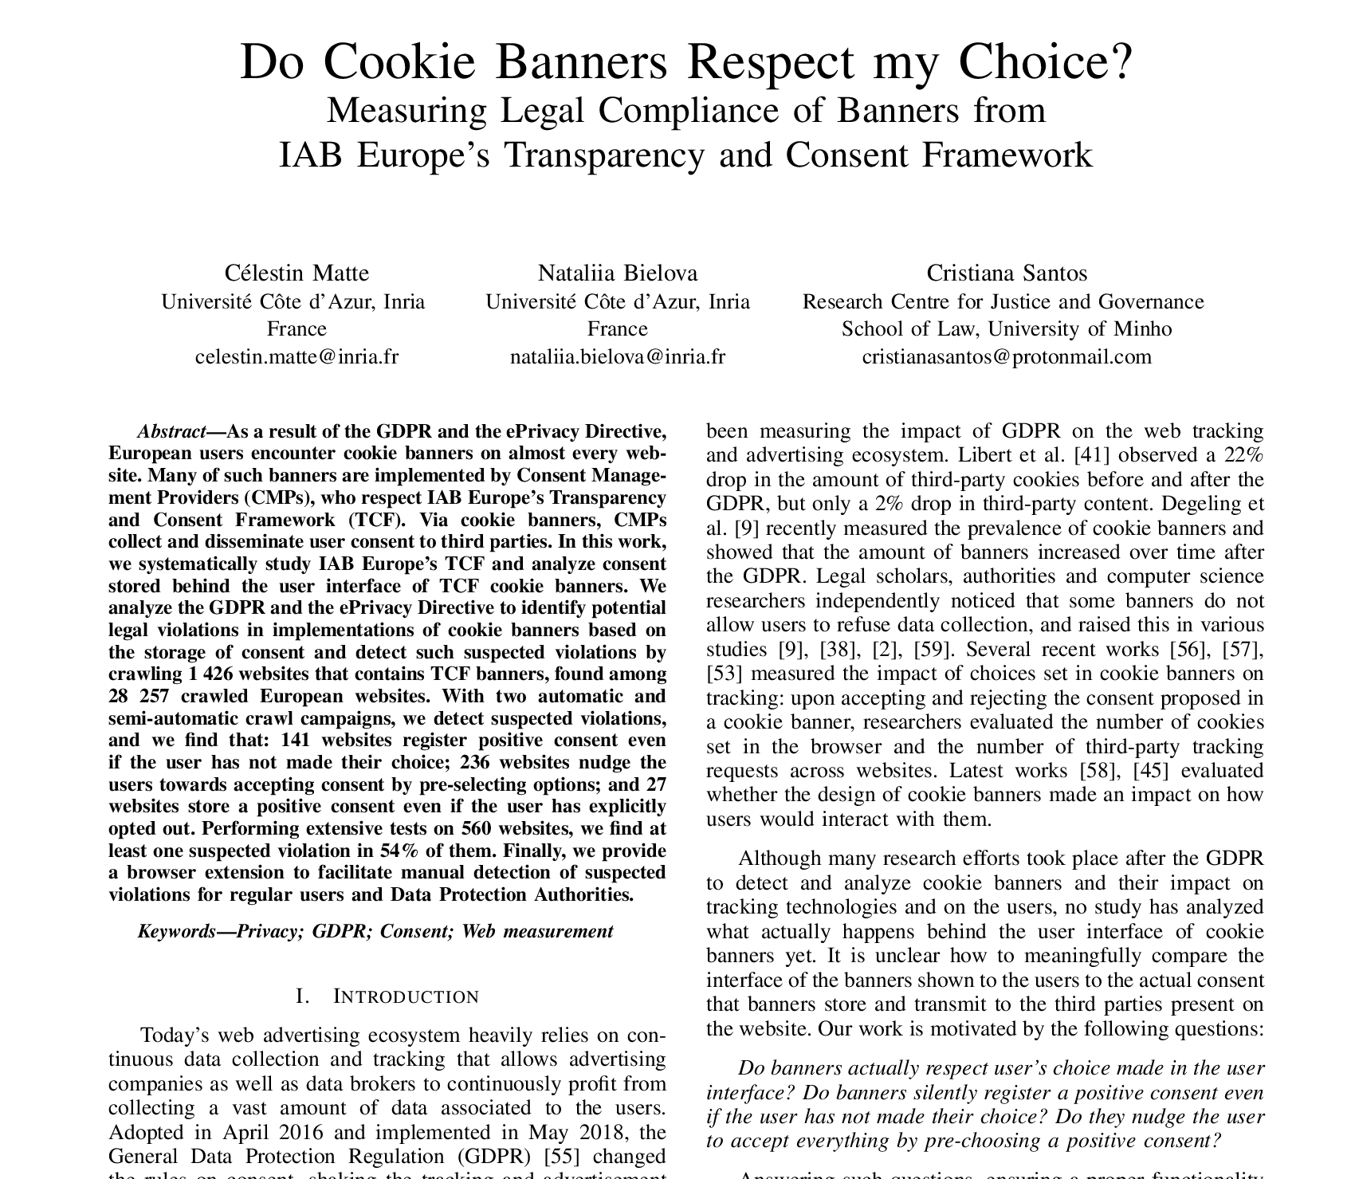
Violations are common on the web
C. Matte, N. Bielova, and C. Santos, “Do Cookie Banners Respect my Choice? : Measuring Legal Compliance
of Banners from IAB Europe’s Transparency and Consent Framework,” 10.1109/SP40000.2020.00076.

Slide 26
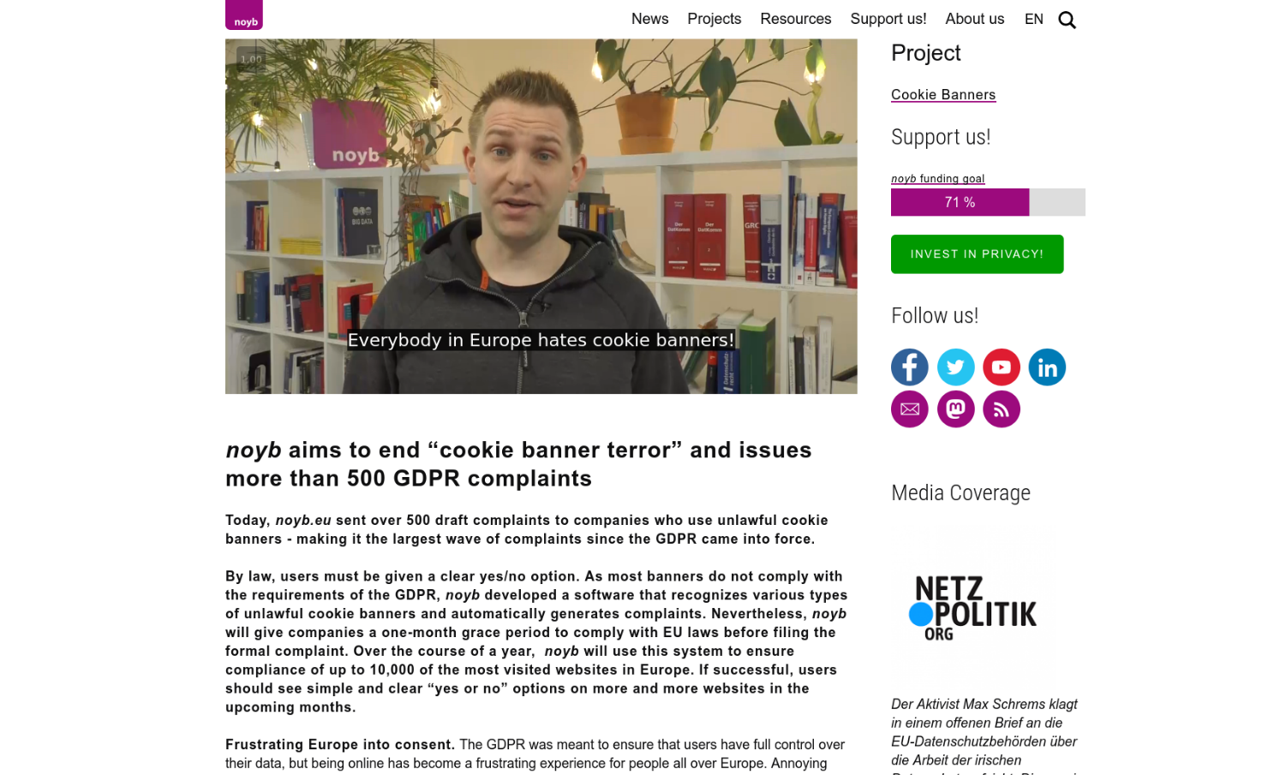
Violations are common on the web
https://noyb.eu/en/noyb-aims-end-cookie-banner-terror-and-issues-more-500-gdpr-complaints

Slide 27
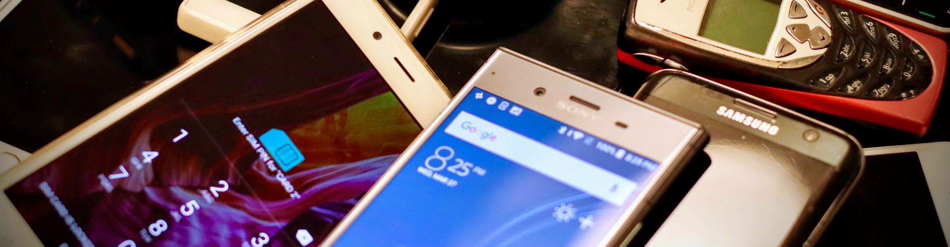
Method
Image: Eirik Solheim (Unsplash license)

Slide 28
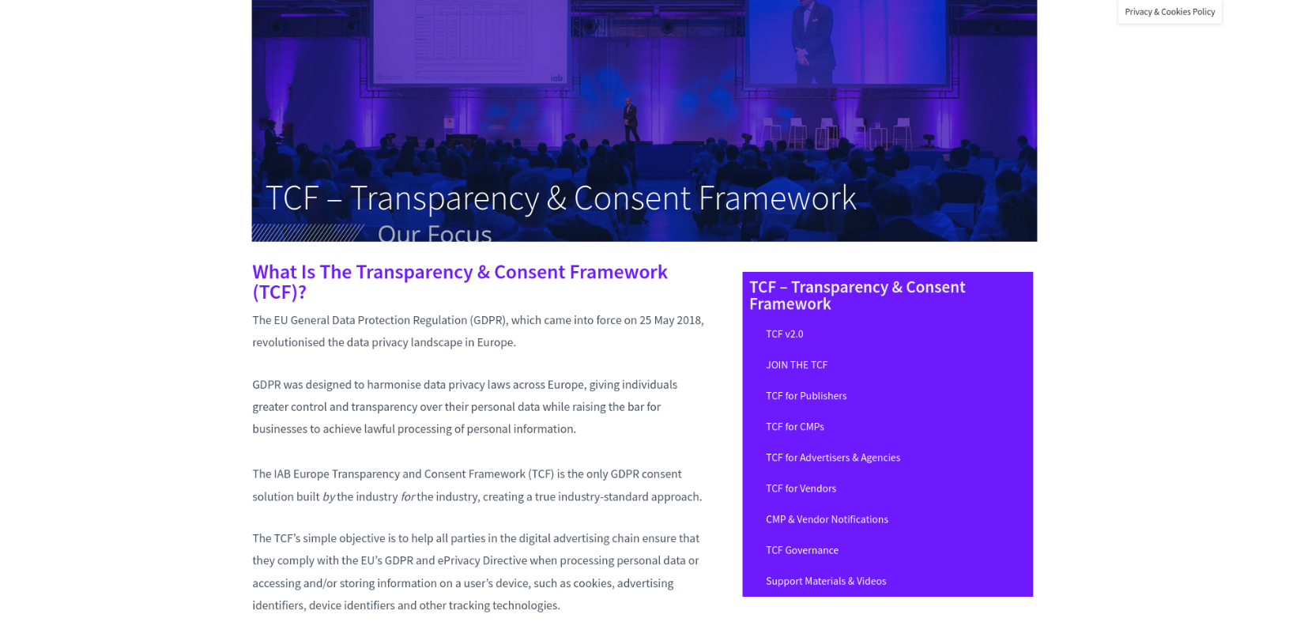
So, how can we find dialogs?
https://iabeurope.eu/transparency-consent-framework/

Slide 29
So, how can we find dialogs?
https://iabeurope.eu/transparency-consent-framework/

Slide 30
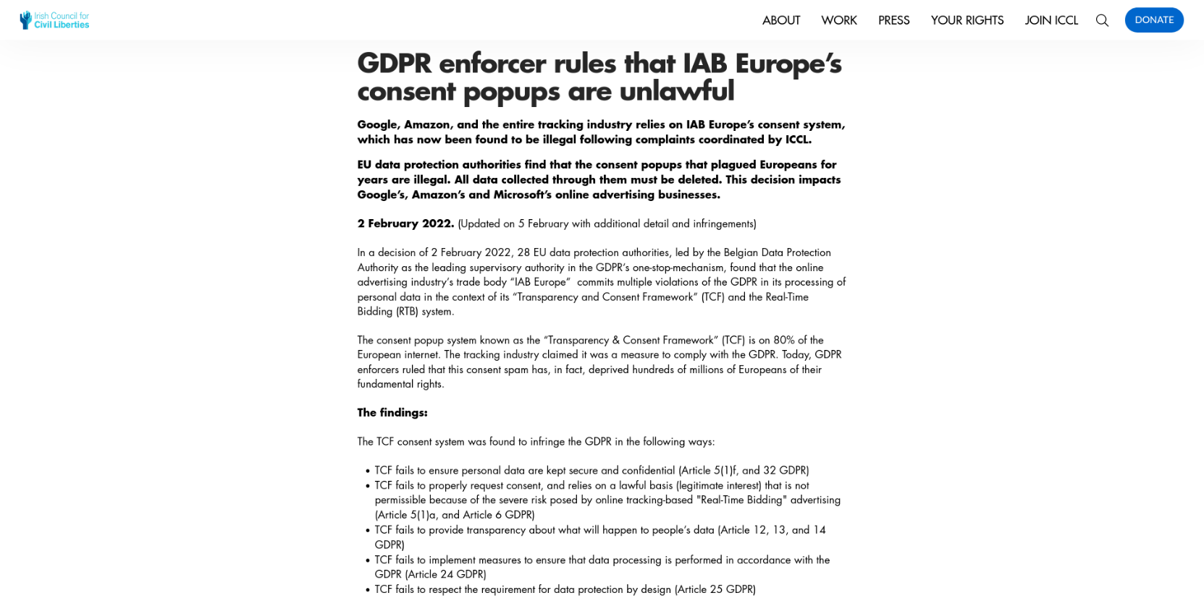
IAB Transparency & Consent Framework
https://www.iccl.ie/news/gdpr-enforcer-rules-that-iab-europes-consent-popups-are-unlawful/

Slide 31
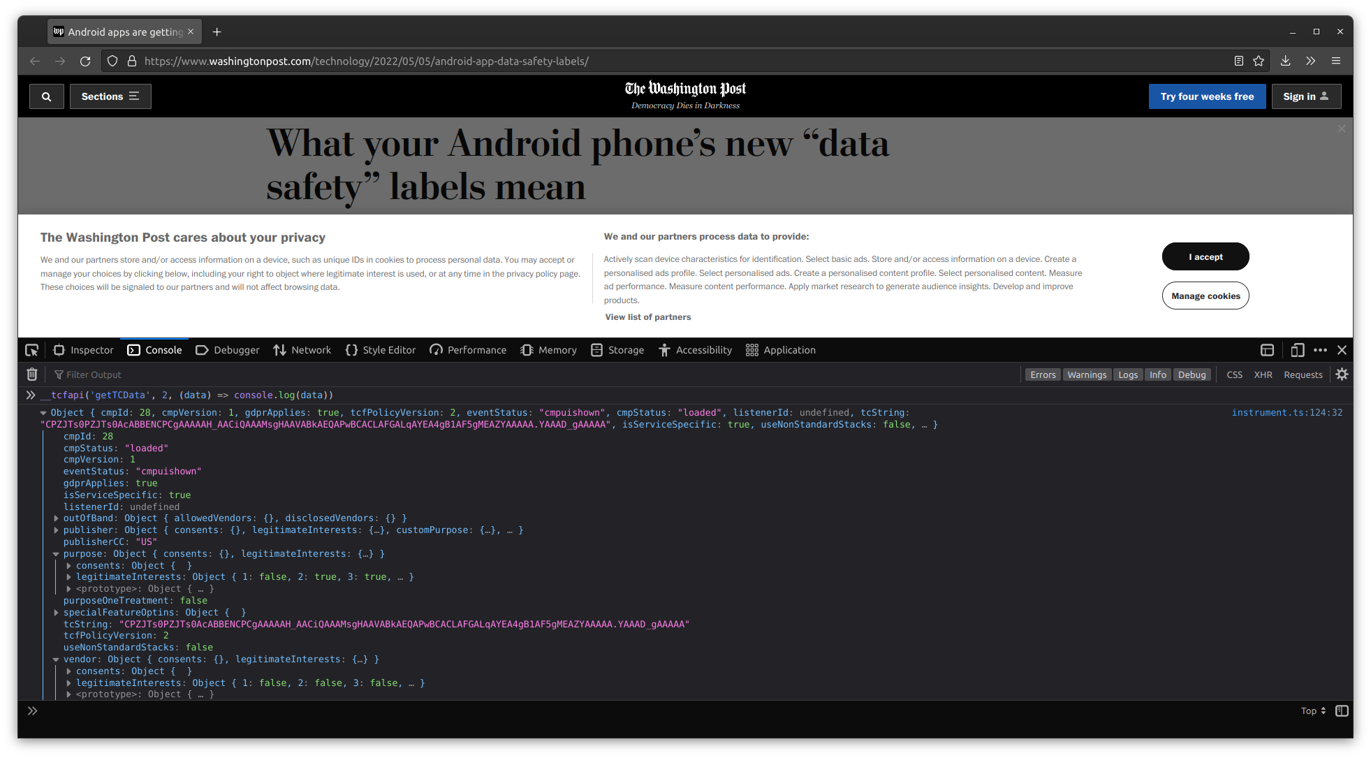
IAB Transparency & Consent Framework

Slide 32
IAB Transparency & Consent Framework

Slide 33
IAB Transparency & Consent Framework

Slide 34
IAB Transparency & Consent Framework
OneTrust

Slide 35
IAB Transparency & Consent Framework

Slide 36
IAB Transparency & Consent Framework

Slide 37
IAB Transparency & Consent Framework

Slide 38
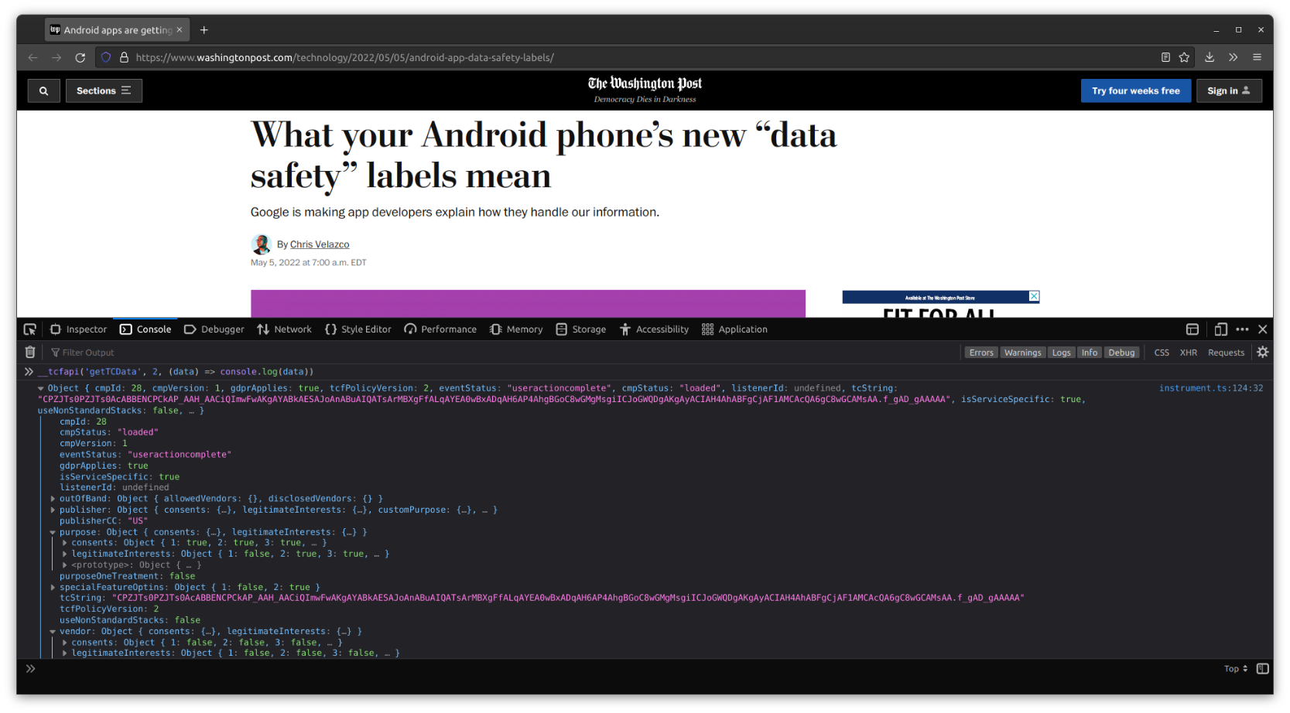
IAB Transparency & Consent Framework

Slide 39
IAB Transparency & Consent Framework

Slide 40
Is that viable?
Quick experiment on 823 Android apps:
21.99 % showed consent element on screen
2.55 % set TCF preferences
=> not viable

Slide 41
Is that viable?
Quick experiment on 823 Android apps:
21.99 % showed consent element on screen
2.55 % set TCF preferences
=> not viable
What about CMP-specific adapters?
Quick experiment on use of known CMPs: 2.8 % on iOS, 7.15 % on Android (over approximation)
=> not viable, either

Slide 42
So, what now?
We have to do text-based matching on common elements in consent dialogs.

Slide 43
So, what now?
We have to do text-based matching on common elements in consent dialogs.
For that, we distinguish between:
link: App only links to privacy policy, e.g. in menu or footer.
notice: App informs user of processing but gives no choice.
dialog: App informs user of processing and solicits active consent.

Slide 44
So, what now?
We have to do text-based matching on common elements in consent dialogs.
For that, we distinguish between:
link: App only links to privacy policy, e.g. in menu or footer.
notice: App informs user of processing but gives no choice.
dialog: App informs user of processing and solicits active consent.
We use regexes that match common phrases, e.g.: /have read( and understood)? [^.]{3,35} (privacy|cookie|data protection|GDPR) (policy|notice|information|statement)/

Slide 45
So, what now?
We have to do text-based matching on common elements in consent dialogs.
For that, we distinguish between:
link: App only links to privacy policy, e.g. in menu or footer.
notice: App informs user of processing but gives no choice.
dialog: App informs user of processing and solicits active consent.
We use regexes that match common phrases, e.g.: /have read( and understood)? [^.]{3,35} (privacy|cookie|data protection|GDPR) (policy|notice|information|statement)/
In addition: keyword score to weed out terms of services notices.

Slide 46
Device instrumentation framework
Basic instrumentation tooling from prior work extended for this thesis.

Slide 47
Device instrumentation framework
Basic instrumentation tooling from prior work extended for this thesis.
Uses emulator for Android, physical iPhone for iOS.

Slide 48
Device instrumentation framework
Basic instrumentation tooling from prior work extended for this thesis.
Uses emulator for Android, physical iPhone for iOS.
Manages apps, sets permissions, resets device, and starts apps.

Slide 49
Device instrumentation framework
Basic instrumentation tooling from prior work extended for this thesis.
Uses emulator for Android, physical iPhone for iOS.
Manages apps, sets permissions, resets device, and starts apps.
Traffic collected using mitmproxy and objection/SSL Kill Switch 2.

Slide 50
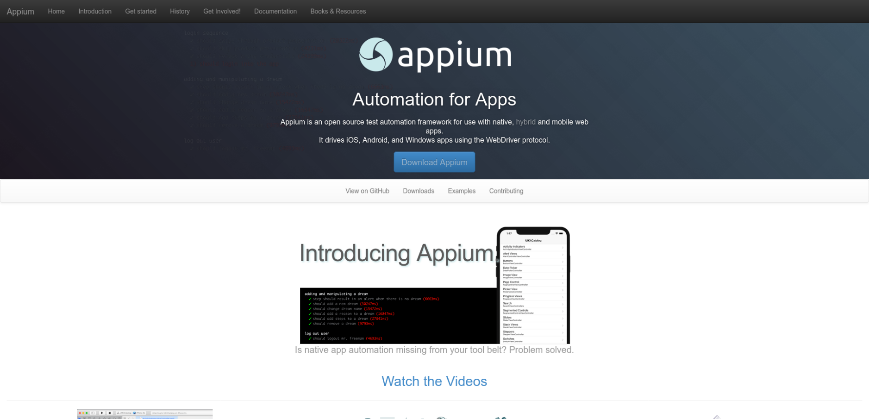
Elements on screen
https://appium.io/

Slide 51
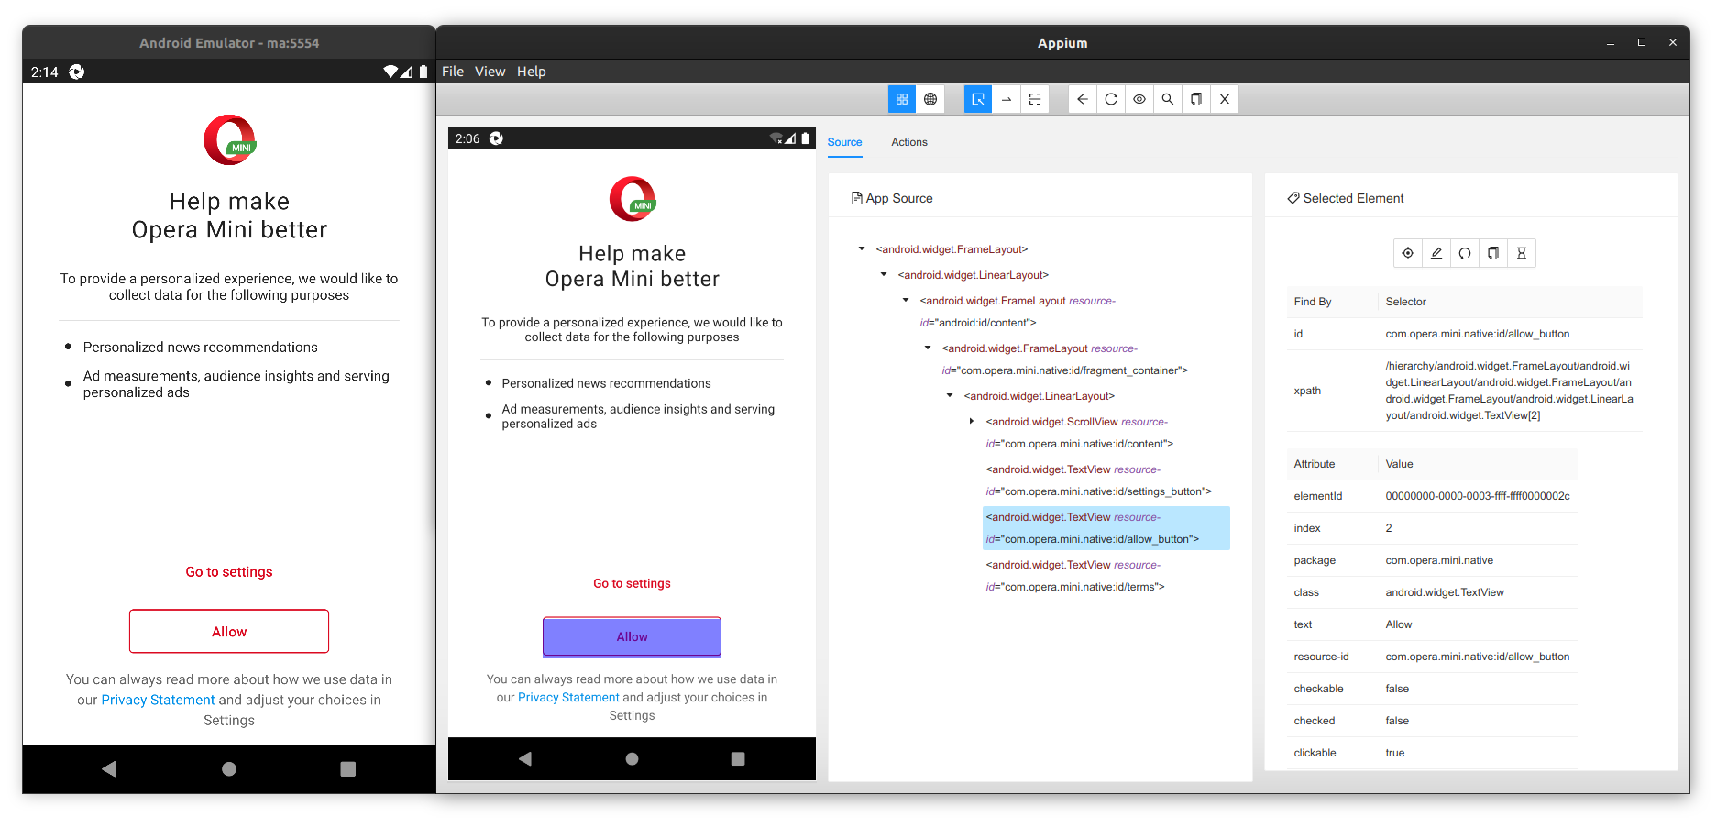
Elements on screen

Slide 52
Elements on screen

Slide 53
Elements on screen

Slide 54
Device instrumentation framework
Basic instrumentation tooling from prior work extended for this thesis.
Uses emulator for Android, physical iPhone for iOS.
Manages apps, sets permissions, resets device, and starts apps.
Traffic collection using mitmproxy and objection/SSL Kill Switch 2.
Analysis of and interaction with elements on screen using Appium.

Slide 55
Device instrumentation framework
Basic instrumentation tooling from prior work extended for this thesis.
Uses emulator for Android, physical iPhone for iOS.
Manages apps, sets permissions, resets device, and starts apps.
Traffic collection using mitmproxy and objection/SSL Kill Switch 2.
Analysis of and interaction with elements on screen using Appium.
Extraction of app preferences using Frida.

Slide 56
Now, we only need apps
Pretty easy on Android:
We scrape the top charts from the Play Store website.
We use PlaystoreDownloader to download them.

Slide 57
Now, we only need apps
Pretty easy on Android:
We scrape the top charts from the Play Store website.
We use PlaystoreDownloader to download them.
From the top 100 apps per category, we successfully downloaded 3,313 apps.

Slide 58
Now, we only need apps
Pretty easy on Android:
We scrape the top charts from the Play Store website.
We use PlaystoreDownloader to download them.
From the top 100 apps per category, we successfully downloaded 3,313 apps.
More involved on iOS:
We discovered an old internal iTunes API for the top charts.
Previous download approaches were manual and unreliable.

Slide 59
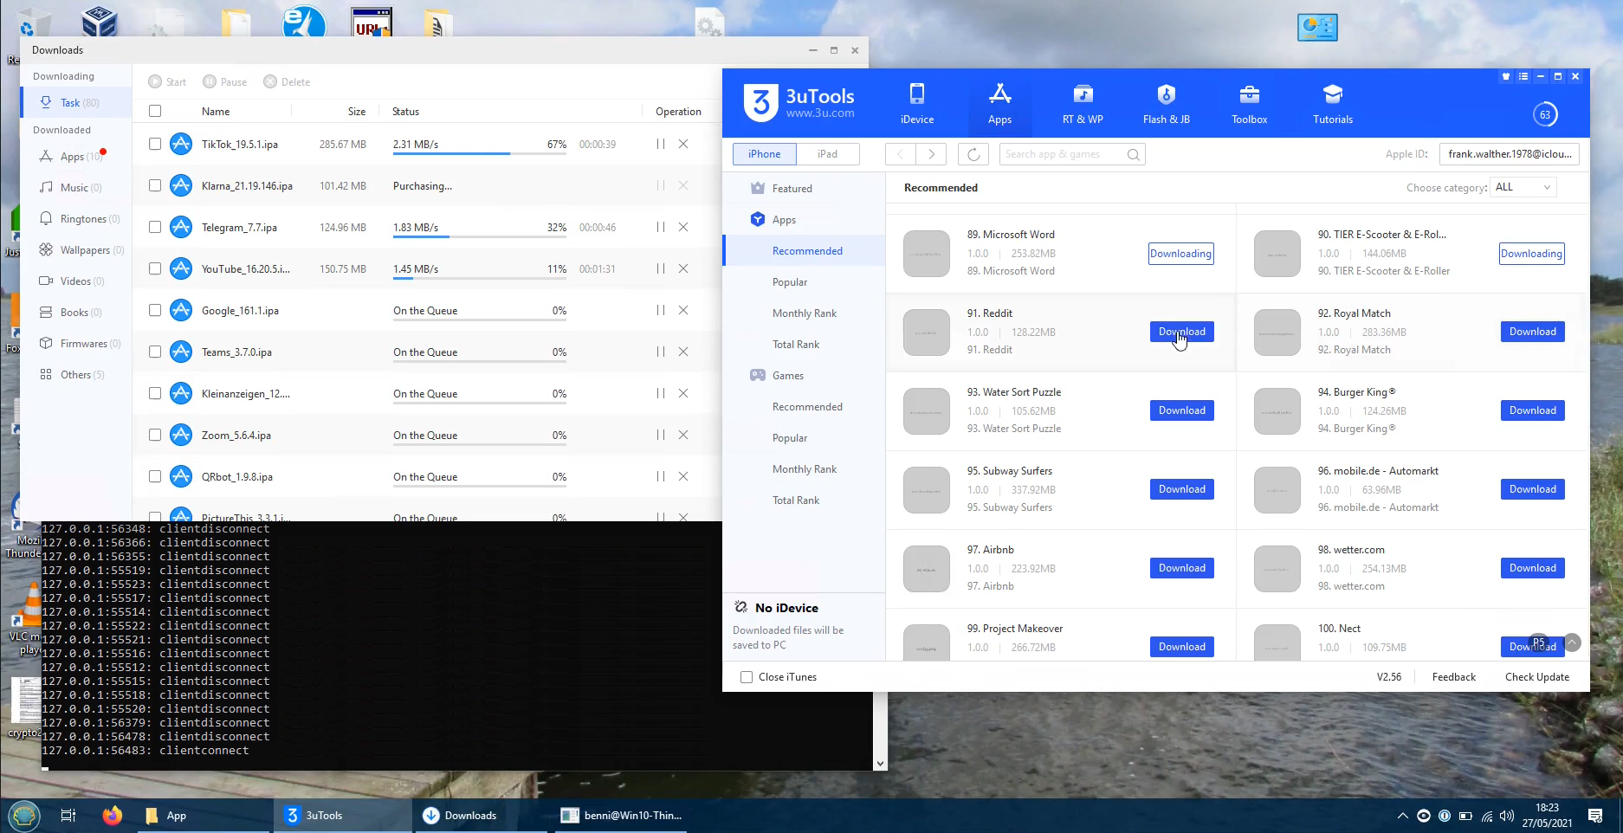
Now, we only need apps
Pretty easy on Android:
We scrape the top charts from the Play Store website.
We use PlaystoreDownloader to download them.
From the top 100 apps per category, we successfully downloaded 3,313 apps.
More involved on iOS:
We discovered an old internal iTunes API for the top charts.
Previous download approaches were manual and unreliable.

Slide 60
Now, we only need apps
Pretty easy on Android:
We scrape the top charts from the Play Store website.
We use PlaystoreDownloader to download them.
From the top 100 apps per category, we successfully downloaded 3,313 apps.
More involved on iOS:
We discovered an old internal iTunes API for the top charts.
Previous download approaches were manual and unreliable.
After a lot of arguing with Apple’s servers, we found a way to programmatically “buy” and download apps.
Extended IPATool with support for that.

Slide 61
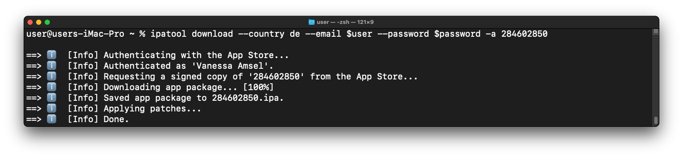
Now, we only need apps
Pretty easy on Android:
We scrape the top charts from the Play Store website.
We use PlaystoreDownloader to download them.
From the top 100 apps per category, we successfully downloaded 3,313 apps.
More involved on iOS:
We discovered an old internal iTunes API for the top charts.
Previous download approaches were manual and unreliable.
After a lot of arguing with Apple’s servers, we found a way to programmatically “buy” and download apps.
Extended IPATool with support for that.

Slide 62
Now, we only need apps
Pretty easy on Android:
We scrape the top charts from the Play Store website.
We use PlaystoreDownloader to download them.
From the top 100 apps per category, we successfully downloaded 3,313 apps.
More involved on iOS:
We discovered an old internal iTunes API for the top charts.
Previous download approaches were manual and unreliable.
After a lot of arguing with Apple’s servers, we found a way to programmatically “buy” and download apps.
Extended IPATool with support for that.
From the top 100 apps per category, we successfully downloaded 2,481 apps.

Slide 63

Results
Image: Adeolu Eletu (Unsplash license)

Slide 64
Prevalence of consent elements
We successfully analysed 4,388 apps: 2,068 (62.42 %) on Android, 2,320 (93.51 %) on iOS.

Slide 65
Prevalence of consent elements
We successfully analysed 4,388 apps: 2,068 (62.42 %) on Android, 2,320 (93.51 %) on iOS.
High number of failures on Android mainly due to certificate pinning bypass.

Slide 66
Prevalence of consent elements
We successfully analysed 4,388 apps: 2,068 (62.42 %) on Android, 2,320 (93.51 %) on iOS.
High number of failures on Android mainly due to certificate pinning bypass.
In total: 785 apps (17.89 %) had one of the consent elements we detect.
Classification | Detections on Android | Detections on iOS | Detections in total
dialog | 149 (7.21 %) | 235 (10.13 %) | 384 (8.75 %)
notice | 108 (5.22 %) | 87 (3.75 %) | 195 (4.44 %)
link | 103 (4.98 %) | 103 (4.44 %) | 206 (4.69 %)
neither | 1,708 (82.59 %) | 1,895 (81.68 %) | 3,603 (82.11 %)

Slide 67
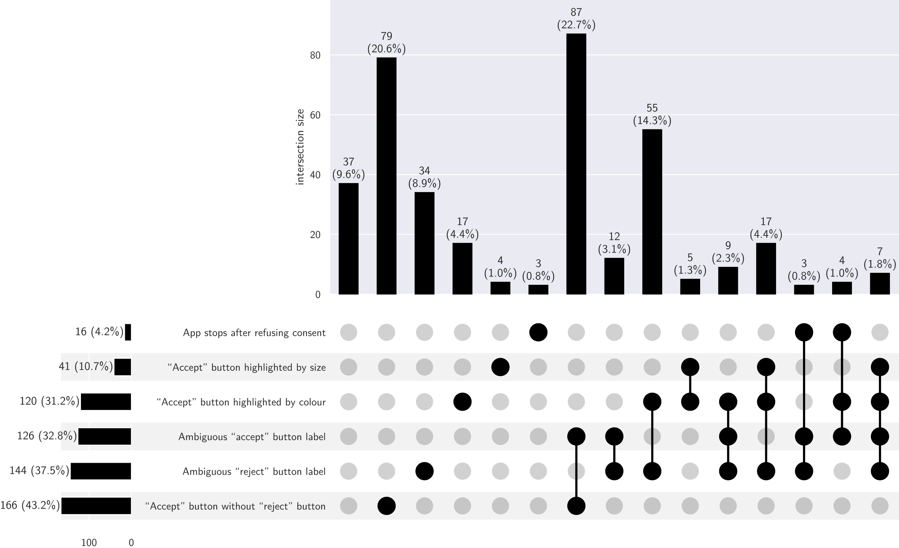
Dark patterns in consent dialogs
UpSet plot of the different combinations of dark patterns we have detected in consent dialogs. Subsets with less than three elements are omitted. Also note that not all combinations are possible.

Slide 68
Dark patterns in consent dialogs
UpSet plot of the different combinations of dark patterns we have detected in consent dialogs. Subsets with less than three elements are omitted. Also note that not all combinations are possible.

Slide 69
Dark patterns in consent dialogs
UpSet plot of the different combinations of dark patterns we have detected in consent dialogs. Subsets with less than three elements are omitted. Also note that not all combinations are possible.

Slide 70
Dark patterns in consent dialogs
UpSet plot of the different combinations of dark patterns we have detected in consent dialogs. Subsets with less than three elements are omitted. Also note that not all combinations are possible.

Slide 71
Dark patterns in consent dialogs
UpSet plot of the different combinations of dark patterns we have detected in consent dialogs. Subsets with less than three elements are omitted. Also note that not all combinations are possible.

Slide 72
Dark patterns in consent dialogs
UpSet plot of the different combinations of dark patterns we have detected in consent dialogs. Subsets with less than three elements are omitted. Also note that not all combinations are possible.

Slide 73
Dark patterns in consent dialogs
UpSet plot of the different combinations of dark patterns we have detected in consent dialogs. Subsets with less than three elements are omitted. Also note that not all combinations are possible.

Slide 74
Dark patterns in consent dialogs
UpSet plot of the different combinations of dark patterns we have detected in consent dialogs. Subsets with less than three elements are omitted. Also note that not all combinations are possible.

Slide 75
Dark patterns in consent dialogs
UpSet plot of the different combinations of dark patterns we have detected in consent dialogs. Subsets with less than three elements are omitted. Also note that not all combinations are possible.

Slide 76
Dark patterns in consent dialogs
UpSet plot of the different combinations of dark patterns we have detected in consent dialogs. Subsets with less than three elements are omitted. Also note that not all combinations are possible.

Slide 77
Violations in consent dialogs
In total: at least one dark pattern in 347 of the 384 apps with a dialog (90.36 %). The share of dark patterns in dialogs is slightly higher on Android (91.28 %) compared to iOS (89.79 %).

Slide 78
Violations in consent dialogs
In total: at least one dark pattern in 347 of the 384 apps with a dialog (90.36 %). The share of dark patterns in dialogs is slightly higher on Android (91.28 %) compared to iOS (89.79 %).
These are not violations on their own! Dark patterns only result in the obtained consent being invalid. The actual violation is tracking based on that supposed consent.

Slide 79
Violations in consent dialogs
In total: at least one dark pattern in 347 of the 384 apps with a dialog (90.36 %). The share of dark patterns in dialogs is slightly higher on Android (91.28 %) compared to iOS (89.79 %).
These are not violations on their own! Dark patterns only result in the obtained consent being invalid. The actual violation is tracking based on that supposed consent.
297 of the 347 apps with a detected dark pattern in their dialog (85.59 %) transmitted pseudonymous data in any of our runs. => 77.34 % of the detected dialogs failed to acquire valid consent for the tracking they perform.

Slide 80
Validation of consent dialog results
Manual validation of consent element detection using screenshots for 250 apps:
Notably: not a single false positive. False negatives expected due to approach and don’t impact validity of detected violations (as these are only for dialogs).
Detected | Actual | Count
neither | link | 1
neither | notice | 2
neither | dialog | 15
link | notice | 2
link | dialog | 5

Slide 81
Validation of consent dialog results
Manual validation of consent element detection using screenshots for 250 apps:
Notably: not a single false positive. False negatives expected due to approach and don’t impact validity of detected violations (as these are only for dialogs).
Manual validation of detected dark patterns for 25 apps: no false positives either, one “accept” button larger than the “reject” button was not detected.
Detected | Actual | Count
neither | link | 1
neither | notice | 2
neither | dialog | 15
link | notice | 2
link | dialog | 5

Slide 82
Data sent to trackers
To analyse transmitted data: as request data is often obfuscated and ridiculously nested, we wrote 26 adapters for common tracking endpoints.

Slide 83
Data sent to trackers
To analyse transmitted data: as request data is often obfuscated and ridiculously nested, we wrote 26 adapters for common tracking endpoints.
These already cover more than 10% of all traffic!

Slide 84
Data sent to trackers
To analyse transmitted data: as request data is often obfuscated and ridiculously nested, we wrote 26 adapters for common tracking endpoints.
These already cover more than 10% of all traffic!
For everything else: indicator matching of honey data.

Slide 85
Data sent to trackers
To analyse transmitted data: as request data is often obfuscated and ridiculously nested, we wrote 26 adapters for common tracking endpoints.
These already cover more than 10% of all traffic!
For everything else: indicator matching of honey data.
72.95 % of apps transmitted unique device ID without interaction.
Also, 33.32 % of requests before interaction were identified as going to trackers according to Exodus, with 78.08 % of apps making at least one request to a tracker.

Slide 86
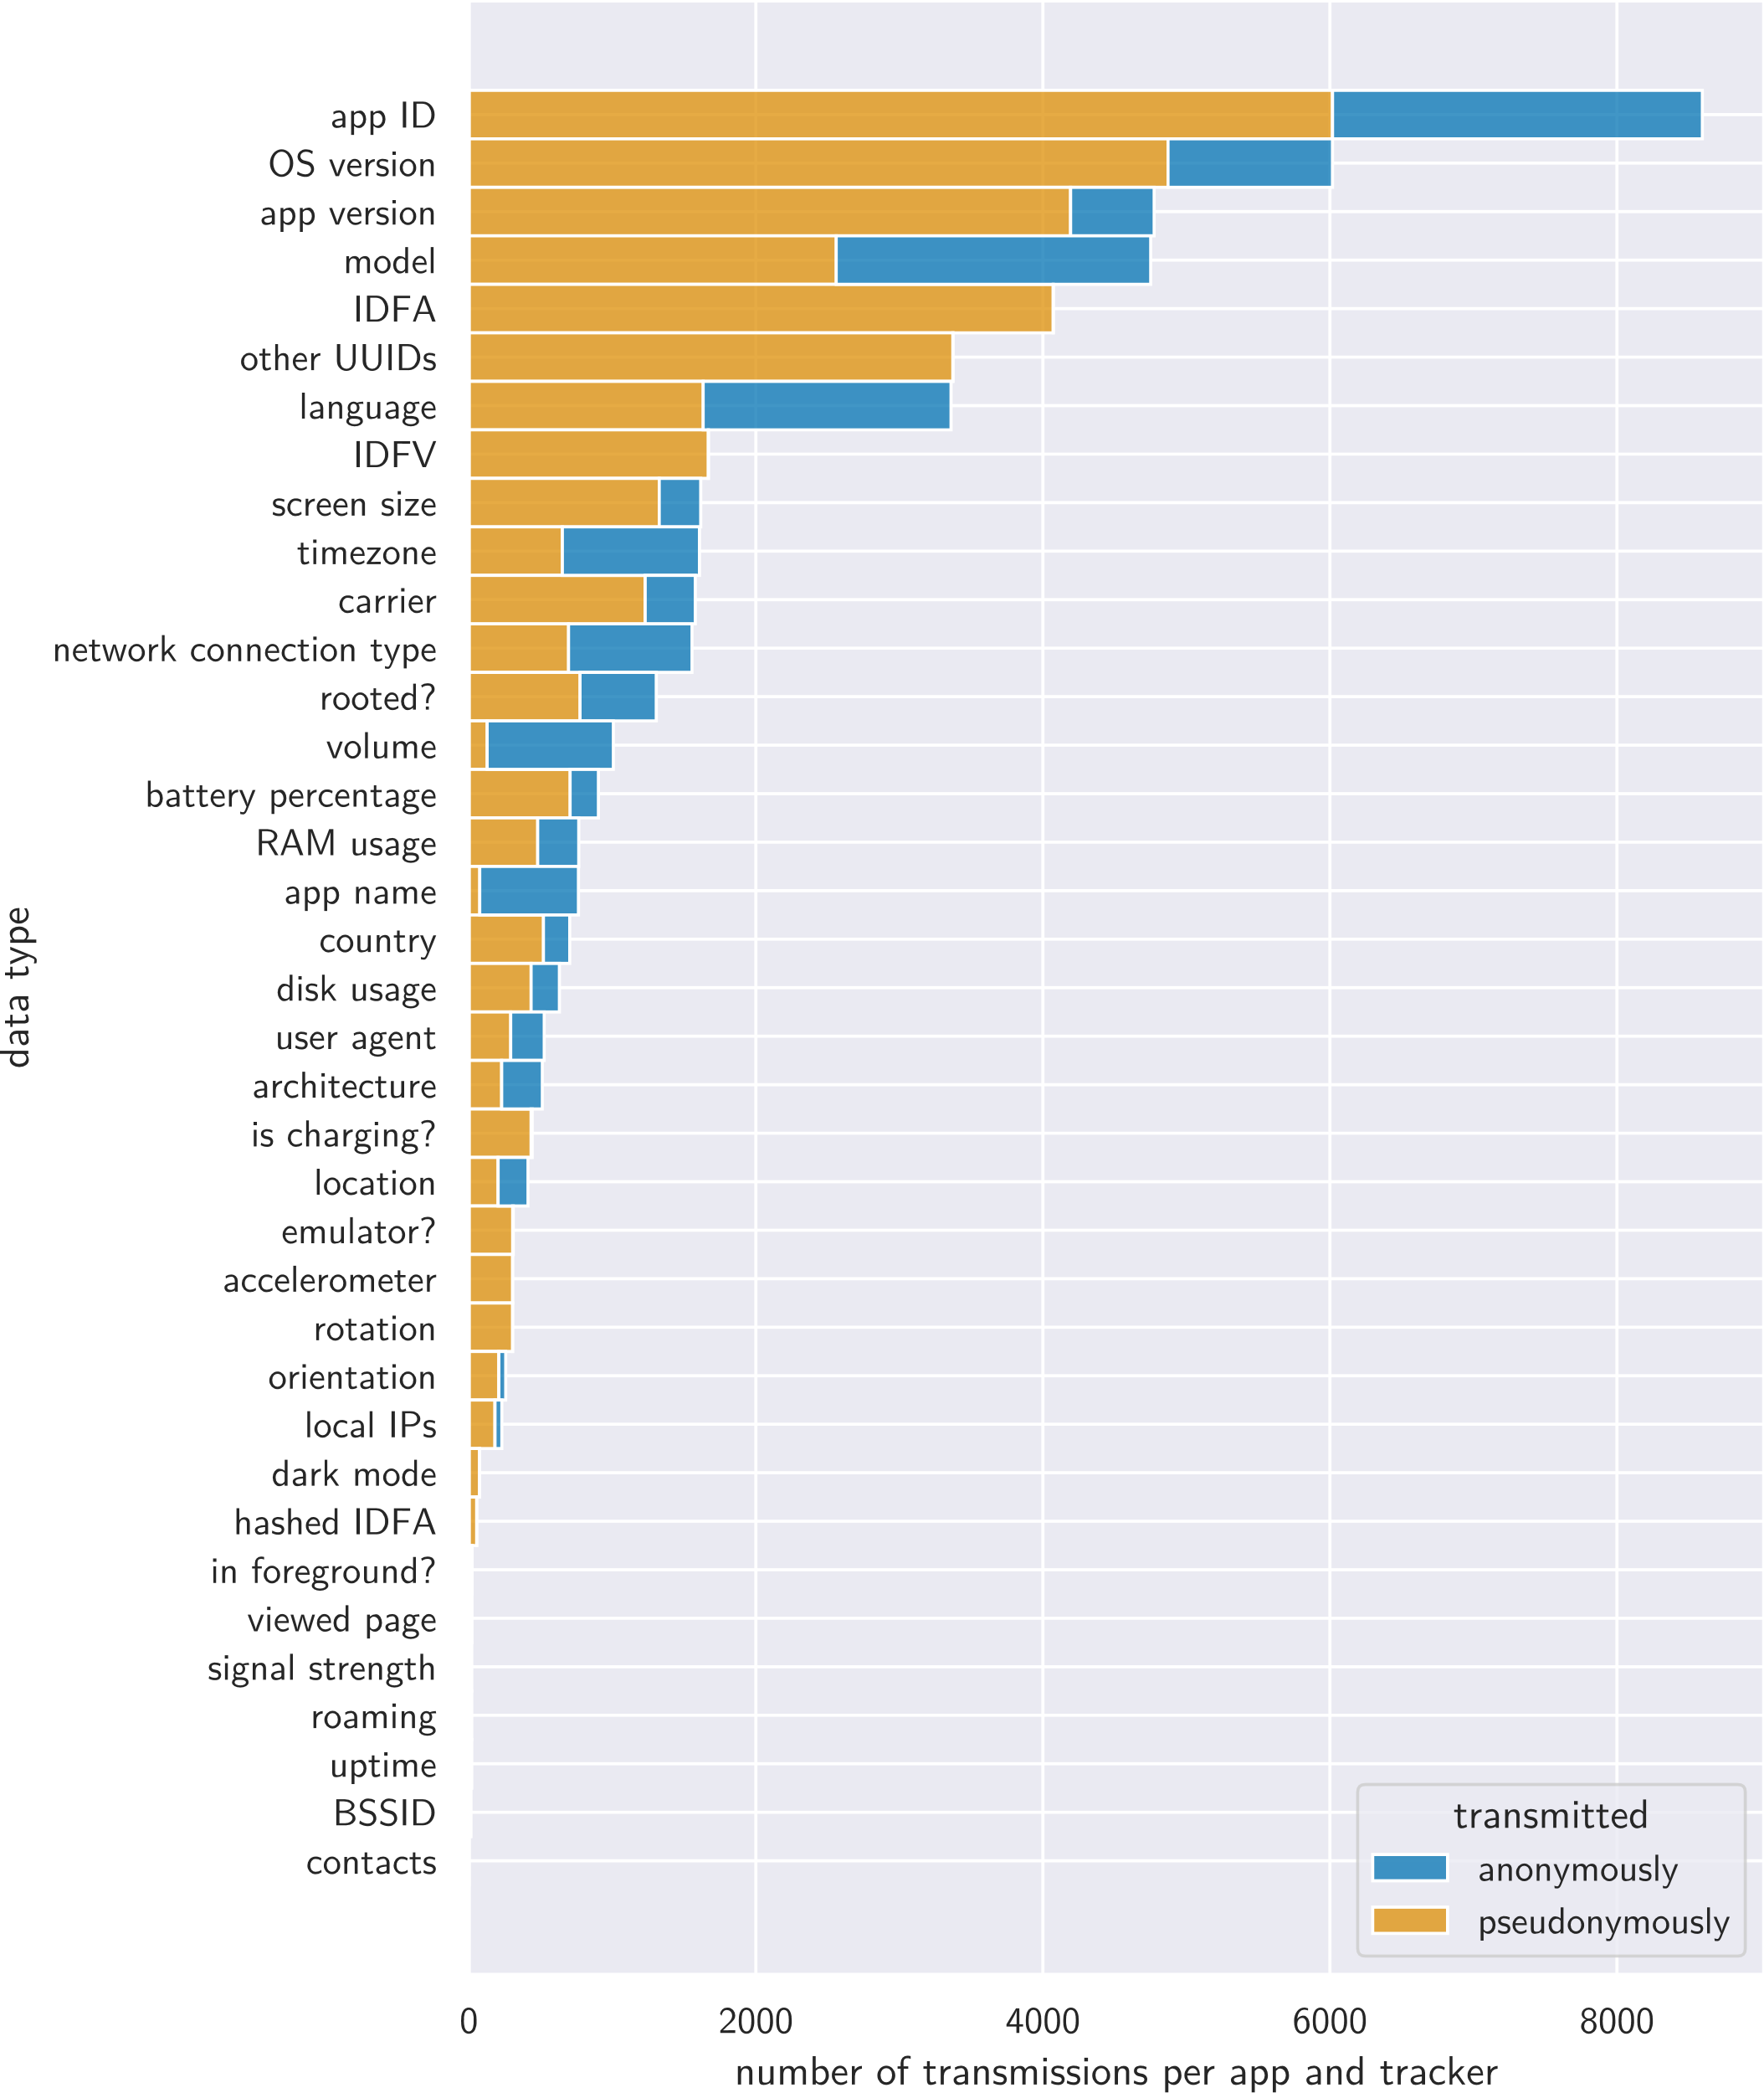
Data types
Number of times the observed data types were transmitted per app and tracker before interaction. Note that we are also using the term “IDFA” for the Android advertising ID here.

Slide 87
Data types
Number of times the observed data types were transmitted per app and tracker before interaction. Note that we are also using the term “IDFA” for the Android advertising ID here.

Slide 88
Data types
Number of times the observed data types were transmitted per app and tracker before interaction. Note that we are also using the term “IDFA” for the Android advertising ID here.

Slide 89
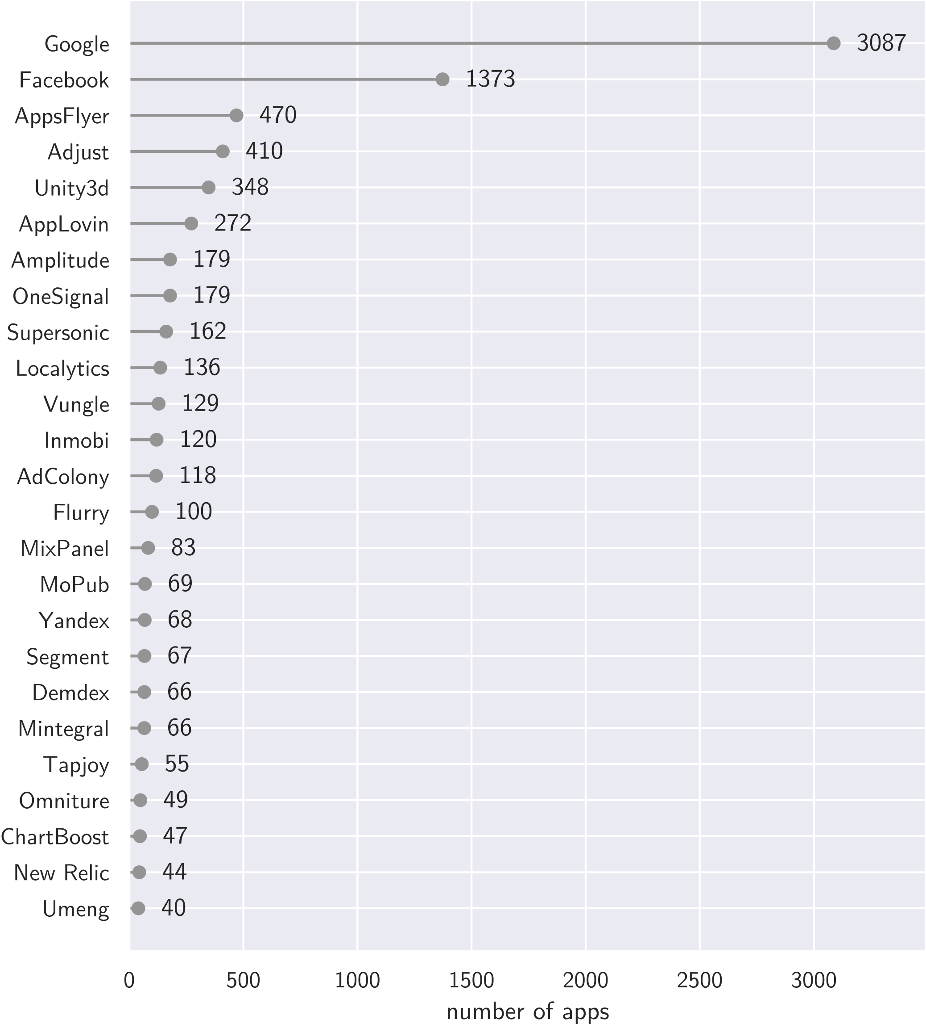
Trackers
Number of apps that sent requests to the 25 most common trackers in our dataset according to Exodus without user interaction.

Slide 90
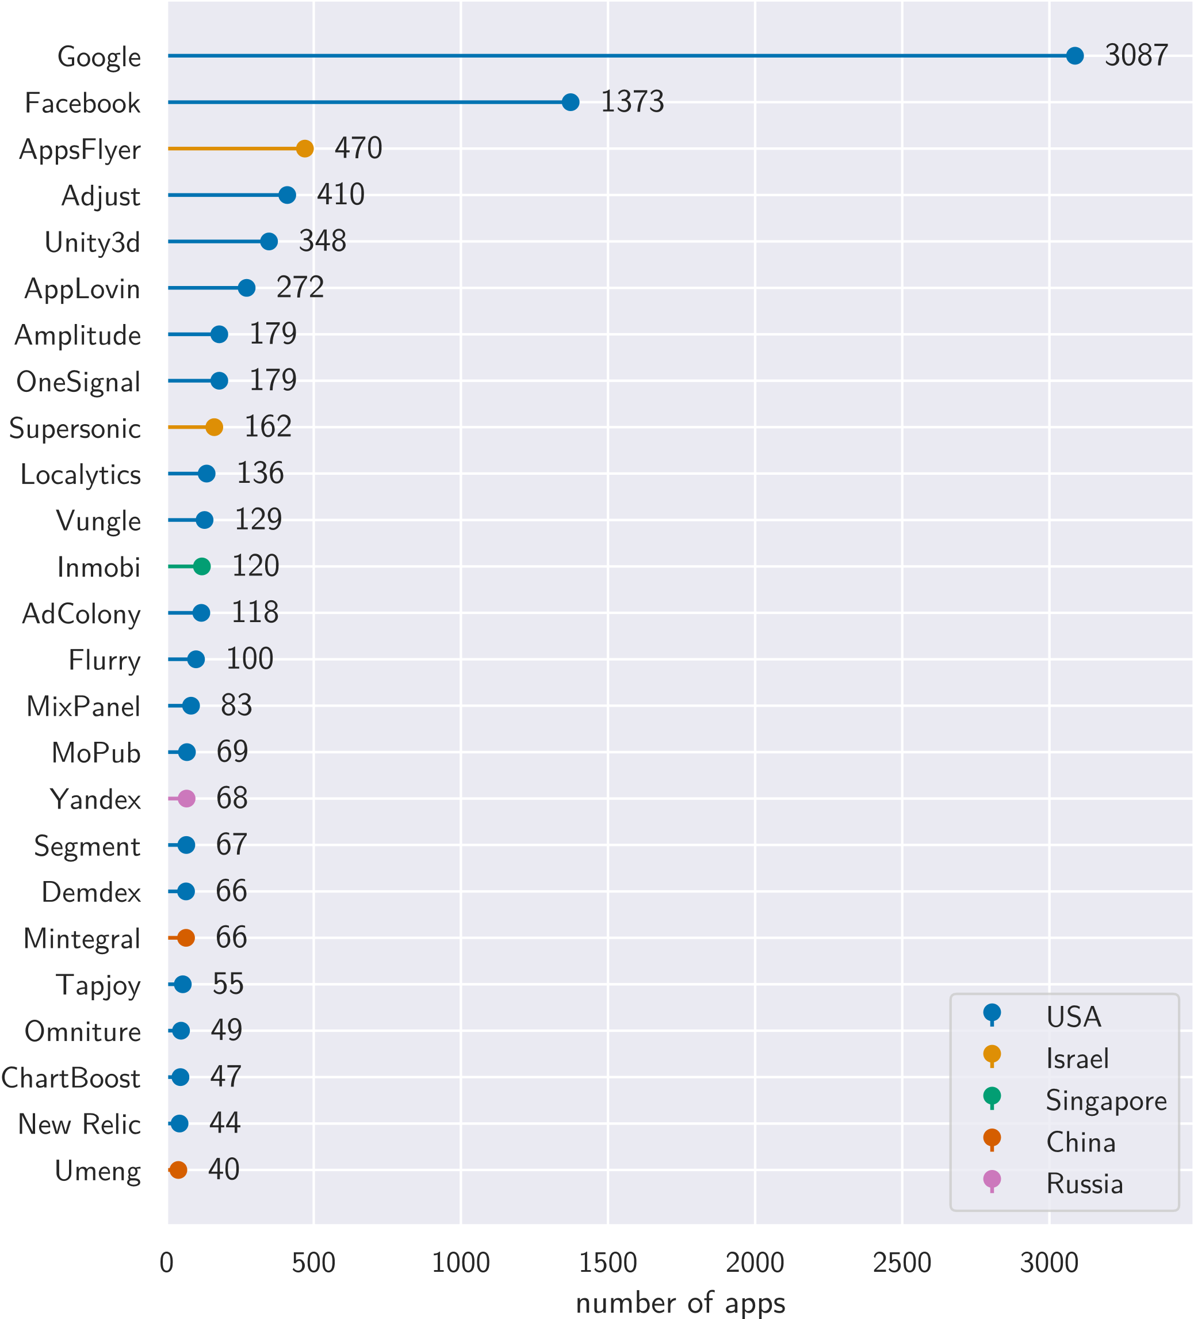
Trackers
Number of apps that sent requests to the 25 most common trackers in our dataset according to Exodus without user interaction.

Slide 91
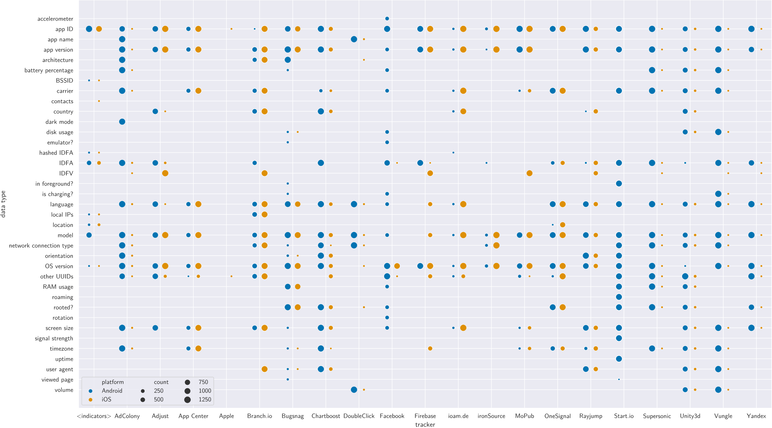
Observed transmissions of data types to trackers without interaction. We are also using “IDFA” for the Android ad ID here. Each point represents a number of apps transmitting the row’s data type to the column’s tracker, with the size indicating how many apps transmitted at least once. The “<indicators>” observations came from indicator matching in the requests not covered by an endpoint-specific tracking request adapter.

Slide 92
Observed transmissions of data types to trackers without interaction. We are also using “IDFA” for the Android ad ID here. Each point represents a number of apps transmitting the row’s data type to the column’s tracker, with the size indicating how many apps transmitted at least once. The “<indicators>” observations came from indicator matching in the requests not covered by an endpoint-specific tracking request adapter.

Slide 93
Observed transmissions of data types to trackers without interaction. We are also using “IDFA” for the Android ad ID here. Each point represents a number of apps transmitting the row’s data type to the column’s tracker, with the size indicating how many apps transmitted at least once. The “<indicators>” observations came from indicator matching in the requests not covered by an endpoint-specific tracking request adapter.

Slide 94
Observed transmissions of data types to trackers without interaction. We are also using “IDFA” for the Android ad ID here. Each point represents a number of apps transmitting the row’s data type to the column’s tracker, with the size indicating how many apps transmitted at least once. The “<indicators>” observations came from indicator matching in the requests not covered by an endpoint-specific tracking request adapter.

Slide 95
Observed transmissions of data types to trackers without interaction. We are also using “IDFA” for the Android ad ID here. Each point represents a number of apps transmitting the row’s data type to the column’s tracker, with the size indicating how many apps transmitted at least once. The “<indicators>” observations came from indicator matching in the requests not covered by an endpoint-specific tracking request adapter.

Slide 96
Observed transmissions of data types to trackers without interaction. We are also using “IDFA” for the Android ad ID here. Each point represents a number of apps transmitting the row’s data type to the column’s tracker, with the size indicating how many apps transmitted at least once. The “<indicators>” observations came from indicator matching in the requests not covered by an endpoint-specific tracking request adapter.

Slide 97
Observed transmissions of data types to trackers without interaction. We are also using “IDFA” for the Android ad ID here. Each point represents a number of apps transmitting the row’s data type to the column’s tracker, with the size indicating how many apps transmitted at least once. The “<indicators>” observations came from indicator matching in the requests not covered by an endpoint-specific tracking request adapter.

Slide 98
Effect of user choices
Analysis interacted with discovered “accept” and “reject” buttons.

Slide 99
Effect of user choices
Analysis interacted with discovered “accept” and “reject” buttons.
Collected traffic for 330 apps (9,342 requests) after accepting, 28 apps (323 requests) after rejecting.

Slide 100
Effect of user choices
Analysis interacted with discovered “accept” and “reject” buttons.
Collected traffic for 330 apps (9,342 requests) after accepting, 28 apps (323 requests) after rejecting.
Remember the low number of dialogs which even have a “reject” button we could click.
=> Results for rejected runs not representative.

Slide 101
Effect of user choices
Analysis interacted with discovered “accept” and “reject” buttons.
Collected traffic for 330 apps (9,342 requests) after accepting, 28 apps (323 requests) after rejecting.
Remember the low number of dialogs which even have a “reject” button we could click.
=> Results for rejected runs not representative.
Of the 384 apps with a detected dialog, 282 (73.44 %) already transmitted pseudonymous data before receiving a consent choice.
 | requests identified as trackers | apps contacting at least one tracker | apps transmitting pseudonymous data
initial runs | 33.32 % | 78.08 % | 72.95 %
accepted runs | 31.90 % | + 25 apps | + 46 apps
rejected runs | 47.06 % | + 1 apps | + 1 apps

Slide 102
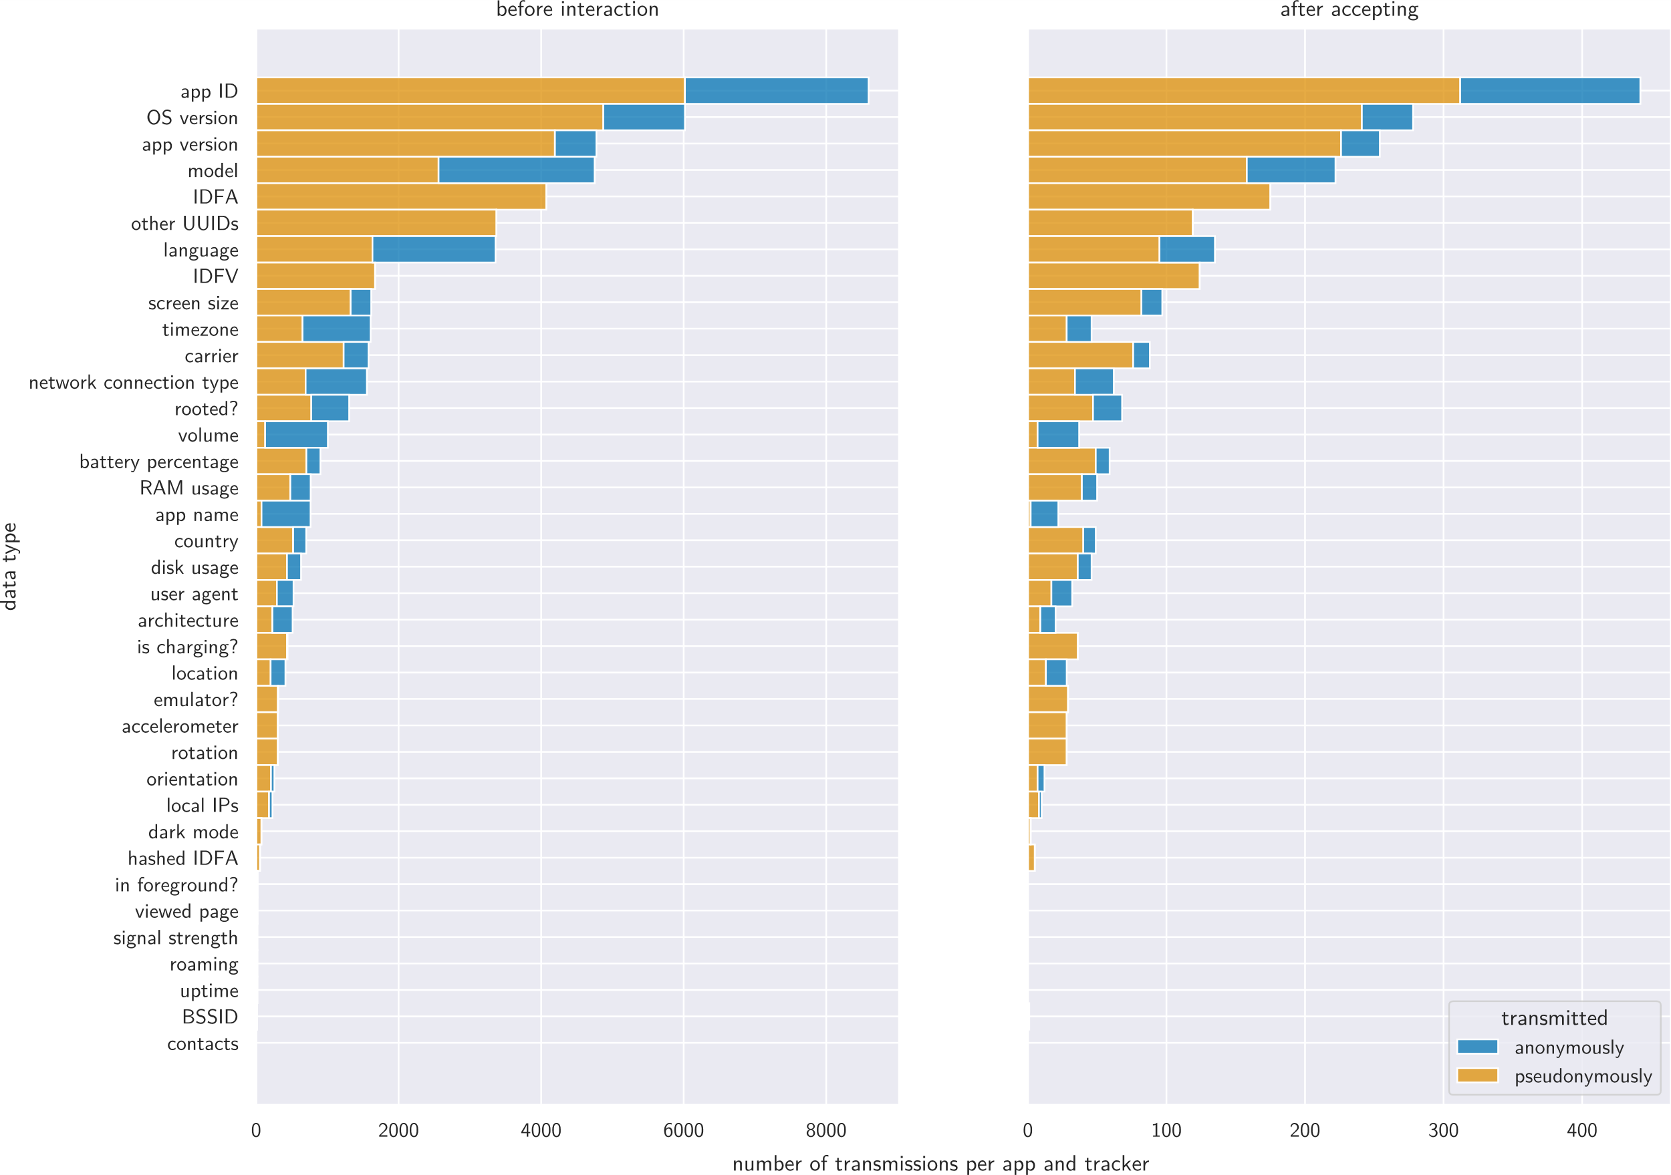
Data types
Number of times the observed data types were transmitted per app and tracker. Note that we are also using the term “IDFA” for the Android advertising ID here.

Slide 103
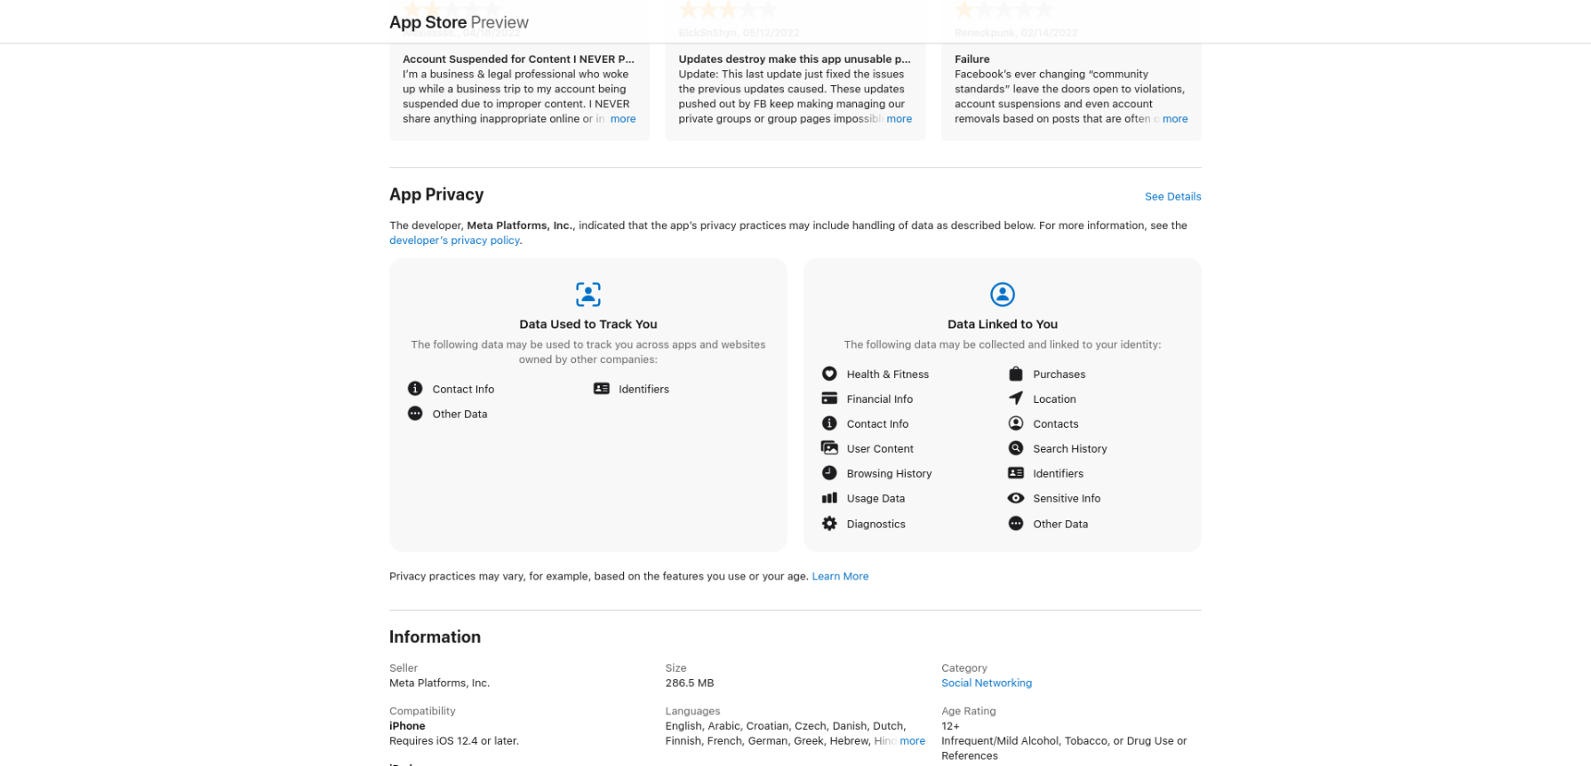
Apple privacy labels
https://apps.apple.com/us/app/facebook/id284882215

Slide 104
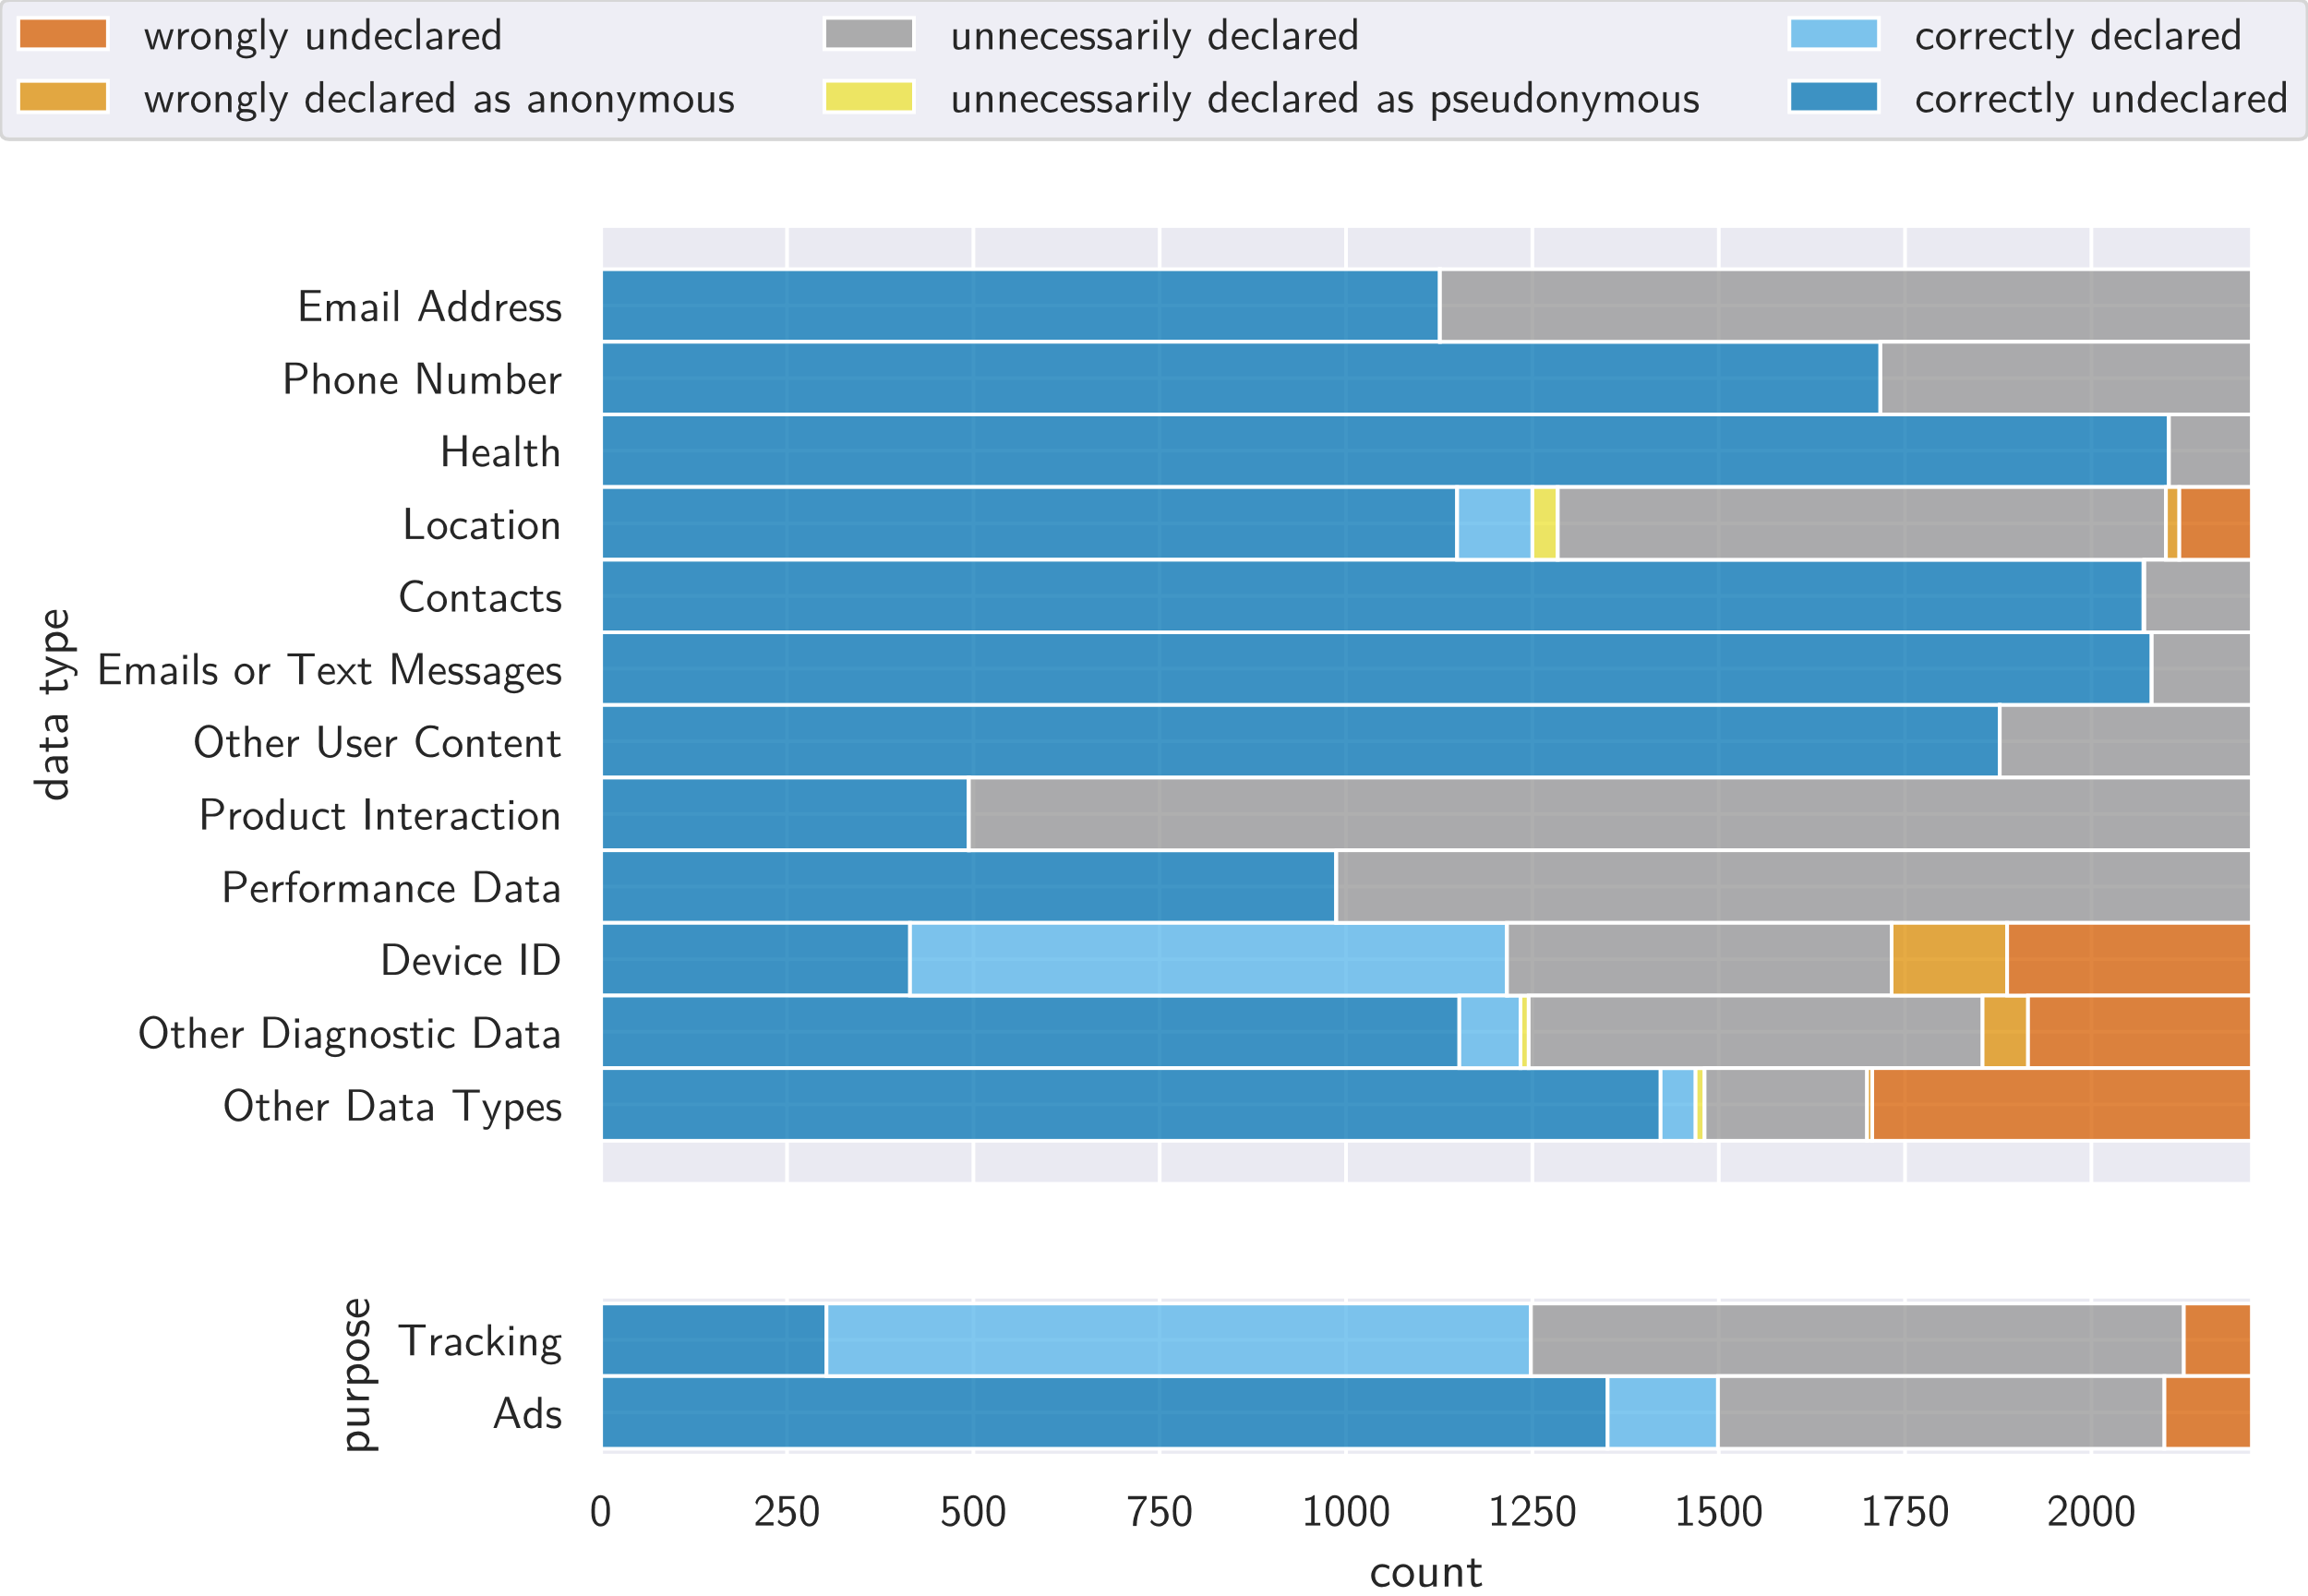
Apple privacy labels
112 of the 2,481 apps on iOS (4.51 %) had an empty privacy label. 182 of them (7.68 %) claimed not to collect any data.
Correctness of data types and purposes in privacy labels on iOS. We can only definitively say when data is collected but if we don’t observe data being transmitted, it does not necessarily mean that it is never collected.

Slide 105
Apple privacy labels
112 of the 2,481 apps on iOS (4.51 %) had an empty privacy label. 182 of them (7.68 %) claimed not to collect any data.
Correctness of data types and purposes in privacy labels on iOS. We can only definitively say when data is collected but if we don’t observe data being transmitted, it does not necessarily mean that it is never collected.

Slide 106
Apple privacy labels
112 of the 2,481 apps on iOS (4.51 %) had an empty privacy label. 182 of them (7.68 %) claimed not to collect any data.
Correctness of data types and purposes in privacy labels on iOS. We can only definitively say when data is collected but if we don’t observe data being transmitted, it does not necessarily mean that it is never collected.

Slide 107
Apple privacy labels
112 of the 2,481 apps on iOS (4.51 %) had an empty privacy label. 182 of them (7.68 %) claimed not to collect any data.
Correctness of data types and purposes in privacy labels on iOS. We can only definitively say when data is collected but if we don’t observe data being transmitted, it does not necessarily mean that it is never collected.

Slide 108
Apple privacy labels
112 of the 2,481 apps on iOS (4.51 %) had an empty privacy label. 182 of them (7.68 %) claimed not to collect any data.
Correctness of data types and purposes in privacy labels on iOS. We can only definitively say when data is collected but if we don’t observe data being transmitted, it does not necessarily mean that it is never collected.

Slide 109
Apple privacy labels
112 of the 2,481 apps on iOS (4.51 %) had an empty privacy label. 182 of them (7.68 %) claimed not to collect any data.
Correctness of data types and purposes in privacy labels on iOS. We can only definitively say when data is collected but if we don’t observe data being transmitted, it does not necessarily mean that it is never collected.

Slide 110
Apple privacy labels
112 of the 2,481 apps on iOS (4.51 %) had an empty privacy label. 182 of them (7.68 %) claimed not to collect any data.
Correctness of data types and purposes in privacy labels on iOS. We can only definitively say when data is collected but if we don’t observe data being transmitted, it does not necessarily mean that it is never collected.

Slide 111
Apple privacy labels
112 of the 2,481 apps on iOS (4.51 %) had an empty privacy label. 182 of them (7.68 %) claimed not to collect any data.
Correctness of data types and purposes in privacy labels on iOS. We can only definitively say when data is collected but if we don’t observe data being transmitted, it does not necessarily mean that it is never collected.

Slide 112
Conclusion
We detected consent elements in around 18 % of apps, with 9 % dialogs, 4 % notices, and 5 % privacy policy links.

Slide 113
Conclusion
We detected consent elements in around 18 % of apps, with 9 % dialogs, 4 % notices, and 5 % privacy policy links.
There are strict criteria for legally compliant consent dialogs.
More than 90 % of analysed apps violate at least one of these criteria, especially the requirement of a first-layer “reject” button.

Slide 114
Conclusion
We detected consent elements in around 18 % of apps, with 9 % dialogs, 4 % notices, and 5 % privacy policy links.
There are strict criteria for legally compliant consent dialogs.
More than 90 % of analysed apps violate at least one of these criteria, especially the requirement of a first-layer “reject” button.
One third of all network traffic was tracking. Google and Facebook are the most common trackers by far.
73 % of apps sent pseudonymous data before any interaction. This also applies to the ones with a dialog.

Slide 115
Conclusion
We detected consent elements in around 18 % of apps, with 9 % dialogs, 4 % notices, and 5 % privacy policy links.
There are strict criteria for legally compliant consent dialogs.
More than 90 % of analysed apps violate at least one of these criteria, especially the requirement of a first-layer “reject” button.
One third of all network traffic was tracking. Google and Facebook are the most common trackers by far.
73 % of apps sent pseudonymous data before any interaction. This also applies to the ones with a dialog.
What companies fail to mention when they blame the GDPR for the flood of consent dialogs: Most of them blatantly violate the GDPR!

Slide 116
Future work
Fix problems with certificate pinning bypass on Android.

Slide 117
Future work
Fix problems with certificate pinning bypass on Android.
Interact with apps beyond consent dialog (being careful not to accidentally give consent).

Slide 118
Future work
Fix problems with certificate pinning bypass on Android.
Interact with apps beyond consent dialog (being careful not to accidentally give consent).
Monitor changes over time.

Slide 119
Future work
Fix problems with certificate pinning bypass on Android.
Interact with apps beyond consent dialog (being careful not to accidentally give consent).
Monitor changes over time.
Research defenses against tracking and metadata extraction.

Slide 120
More reading and watching material
B. Altpeter and M. Wessels, “Do they track? Automated analysis of Android apps for privacy violations,” https://benjamin-altpeter.de/doc/presentation-android-privacy.pdf.
B. Altpeter, “iOS watching you: Automated analysis of ‘zero-touch’ privacy violations under iOS,” https://benjamin-altpeter.de/doc/presentation-ios-privacy.pdf.
M. Schrems, “Datenschutz skalieren,” https://www.bfdi.bund.de/SharedDocs/Videos/DE/Veranstaltungen/20220322_Datenschutz-skalieren.html.
Konferenz der unabhängigen Datenschutzaufsichtsbehörden des Bundes und der Länder, “Orientierungshilfe der Aufsichtsbehörden für Anbieter:innen von Telemedien ab dem 1. Dezember 2021,” https://www.datenschutzkonferenz-online.de/media/oh/20211220_oh_telemedien.pdf.

Slide 121
This slide intentionally left blank.

Slide 122
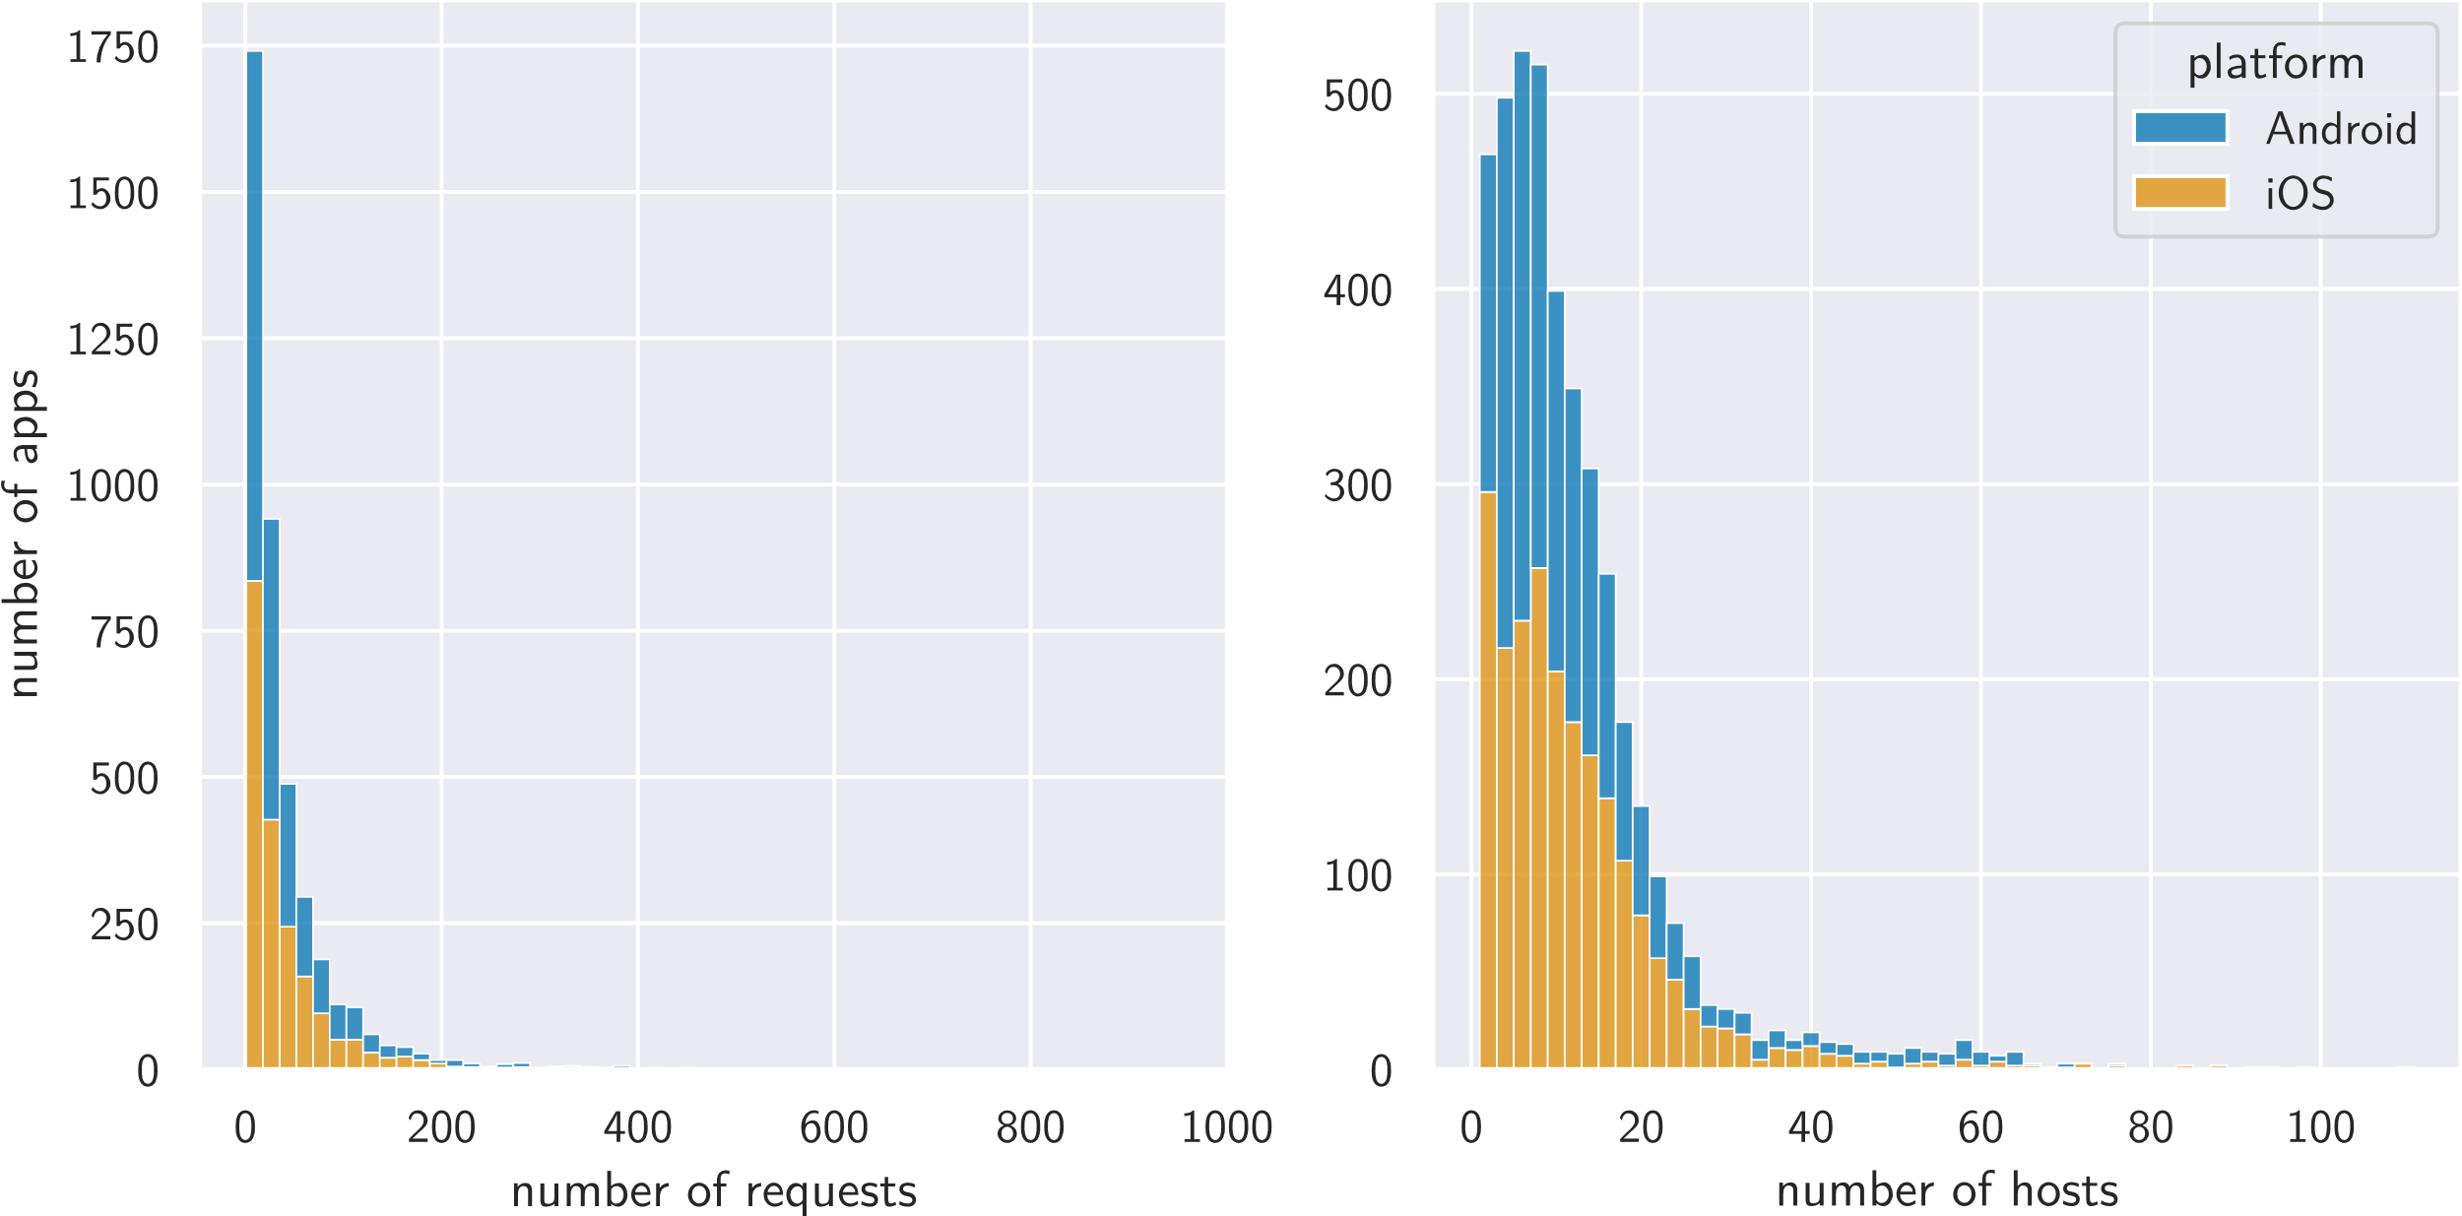
Requests and hosts
Number of requests and unique hosts contacted per app without any user interaction. Three apps with more than 1,000 requests are omitted in this graph: com.prequel.app on Android with 2,500 requests, and com.audiomack.iphone and com.storycover on iOS with 2,383 and 1,019 requests, respectively.

Slide 123
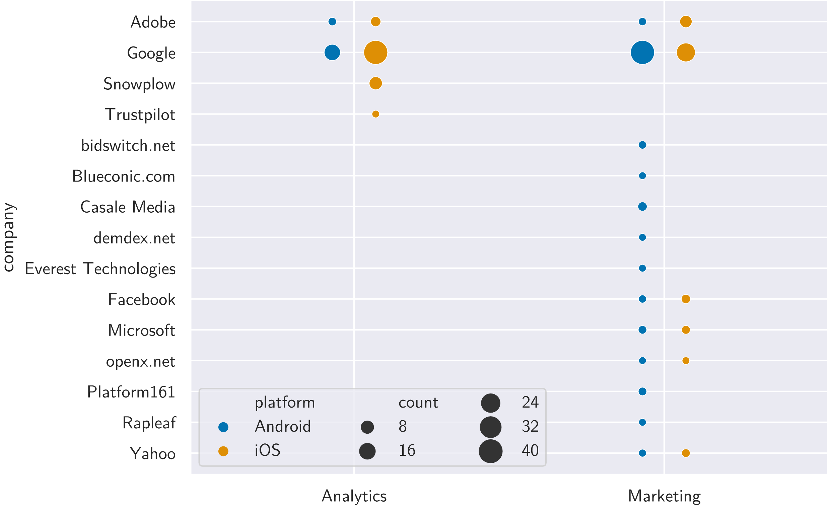
Cookies
Prevalence of cookies by various companies and their categories (across all runs). Each point represents the number of times a cookie by the company in the respective row and belonging to the category in the respective column was set by an app to a different value, with the size of the point indicating how often the cookie was set.

Slide 124
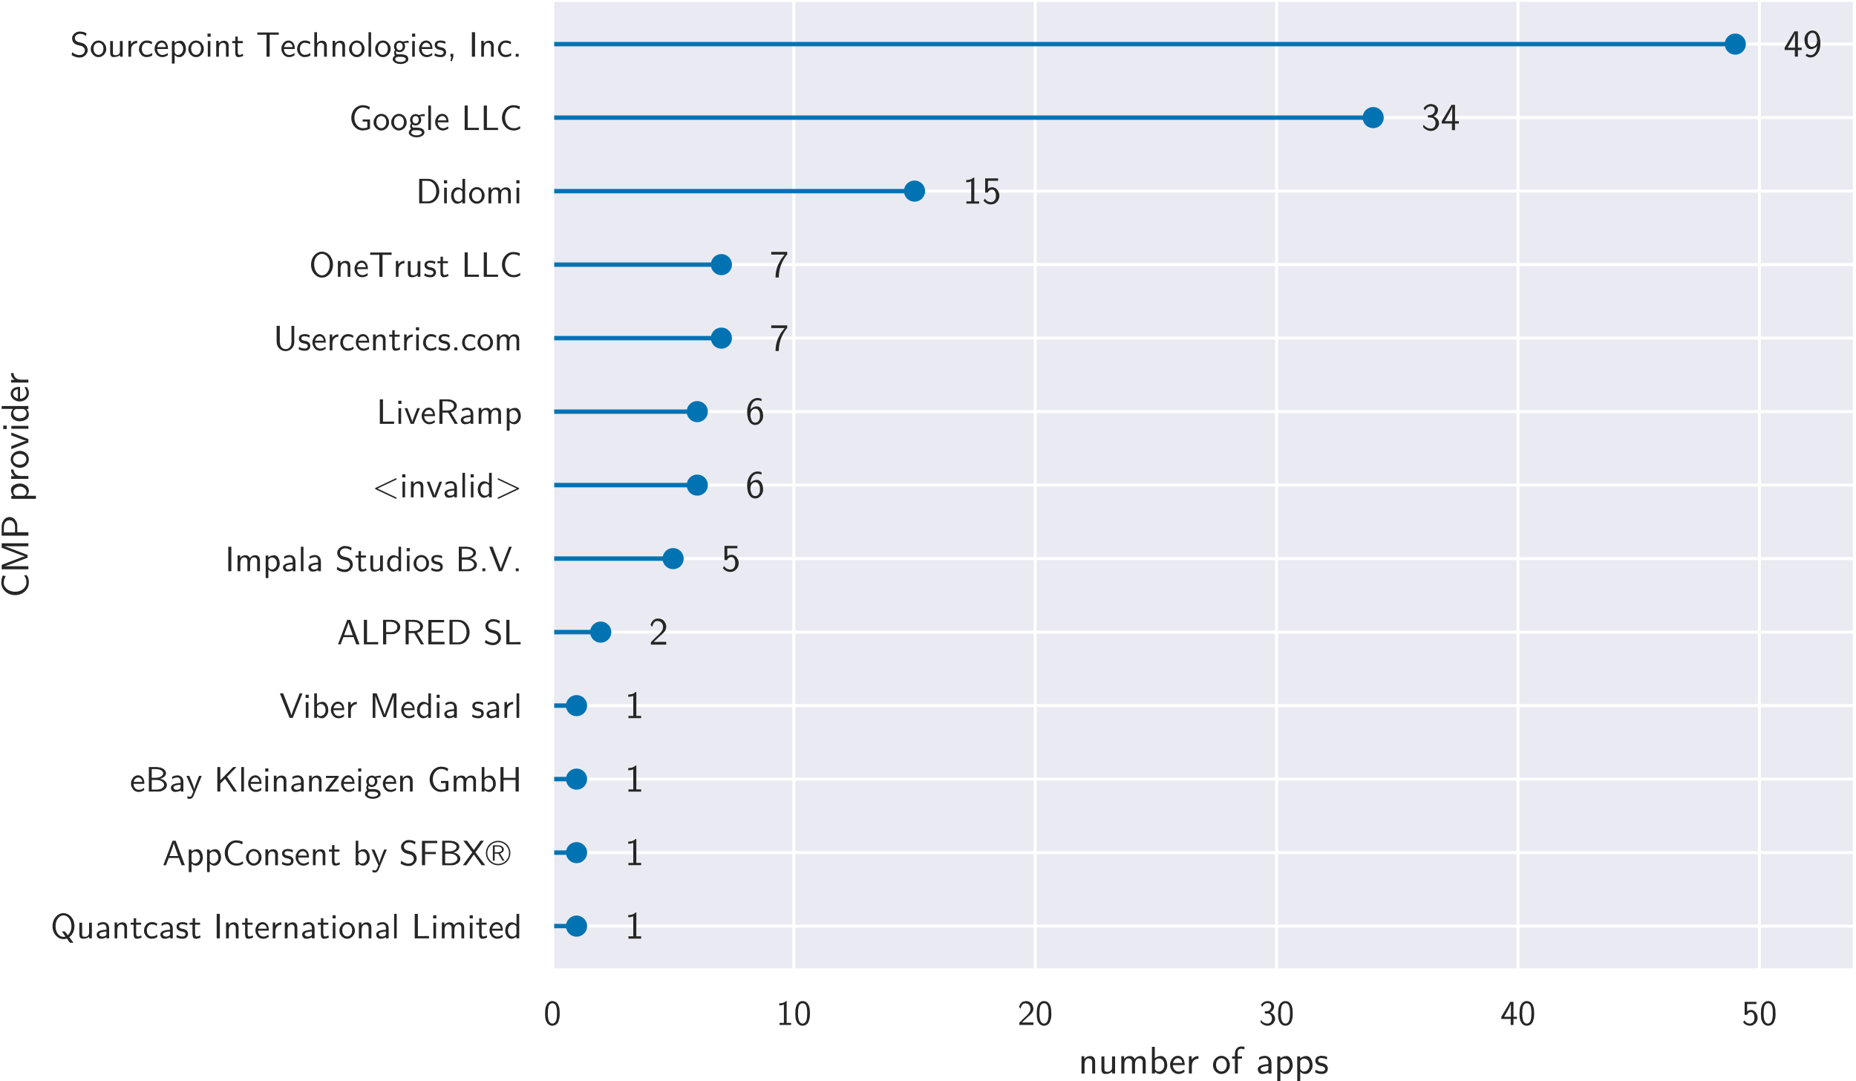
IAB TCF data
Prevalence of CMP providers according to IAB TCF data.

Slide 125
IAB TCF data
163 of the analysed apps have saved IABTCF preferences (64 on Android, and 99 on iOS).
Of those, 61 were not detected as having a consent dialog by our approach. Manually analysing those showed that 17 do in fact show a dialog that we did not detect but the remaining 44 do not. Conversely, 282 apps were detected as showing a dialog but have not saved IABTCF preferences.
The apps most often set the IABTCF_gdprApplies property, with 125 apps setting the property initially, another 27 only setting it after accepting the dialog, and one app setting it only after rejecting. In total, 145 apps determine the GDPR to be applicable, 6 apps (incorrectly) determine it not to be, and 2 apps set non-spec-compliant values . None of the apps changed their determination after accepting or rejecting the dialog.

Slide 126
IAB TCF data
IABTCF_PublisherCC specifies the app publisher’s country. 62 apps are from Germany according to this, for 22 the CMP didn’t know the country, seven are from the US, five from the Netherlands, and three from Spain. The following countries are each represented once: France, Hong Kong, Luxembourg, Japan, United Kingdom, and Australia.
Most apps store consent for all ten purposes, with an average of 9.10 and a median of 10.
The average for the amount of stored vendor consents is 361.75, the median is 158 (maximum possible: 860). All possible vendors were requested by at least seven apps.
Of the 68 apps that initially store a TC string, 63 showed an English consent dialog (our devices were set to English), and five showed a dialog in German.

Slide 127
Failed apps
We successfully analysed 4,388 apps with 2,068 apps on Android and 2,320 apps on iOS, corresponding to 62.42 % and 93.51 % of the downloaded apps, respectively. On Android, the high number of apps we could not analyse is caused for the most part by problems with the certificate pinning bypass through objection.
1,049 of the Android apps failed to launch or quit immediately after being launched through objection. These apps were excluded from the analysis. We discuss this further in Section 8.2. On iOS, only 65 apps failed to launch and 18 apps could not be installed because they require a newer version of iOS than we can use. The remaining failures on both platforms were mostly due to Appium or Frida commands failing even after multiple retries.

Slide 128
Limitations
We only provide lower bound on consent element prevalence and dark patterns.
Appium doesn’t expose the text in all games, sometimes missing (esp. games).
Appium only allows limited access to element attributes, e.g. no link targets or styling.
String matching approach limits the details we can extract.
We only detect English and German consent elements.
Apps could try to re-identify our device using fingerprinting despite us resetting it.
Apps could interpret lack of IDFA permission on iOS as refusal of consent.
32 % of apps on Android quit immediately due to objection.
Root/jailbreak and emulator could affect app behaviour.
HTTPS proxy and certificate pinning bypass could affect app behaviour.

